Slide 1
Introduction to Computing for Data Analysis
Compression via PCA+SVD
Richard Vuduc, Ph.D.
Associate Professor
School of Computational Science and Engineering
Truncated SVD
Notes:
Greetings, Earthling, it’s time for our next topic: the truncated SVD, which stands for the *singular value decomposition.*
The SVD is the “Swiss Army Knife” of linear algebra.

Slide 2
Introduction to Computing for Data Analysis
Compression via PCA+SVD
Richard Vuduc, Ph.D.
Associate Professor
School of Computational Science and Engineering
Truncated SVD
Notes:
What I want you to do is use the SVD to solve the eigenproblem that arises in PCA, or principal components analysis.
So let’s begin!

Slide 3

Notes:
Here is the eigenproblem we want to solve. @TODO: Show title

Slide 4
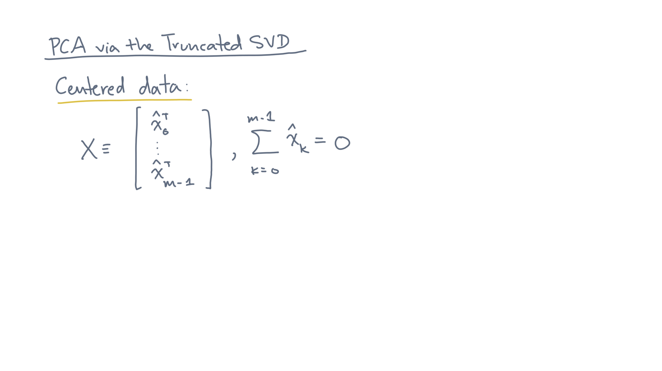
Notes:
You are given a data matrix, X, that consists of m *centered* data points. @TODO: Show and highlight “centered”

Slide 5
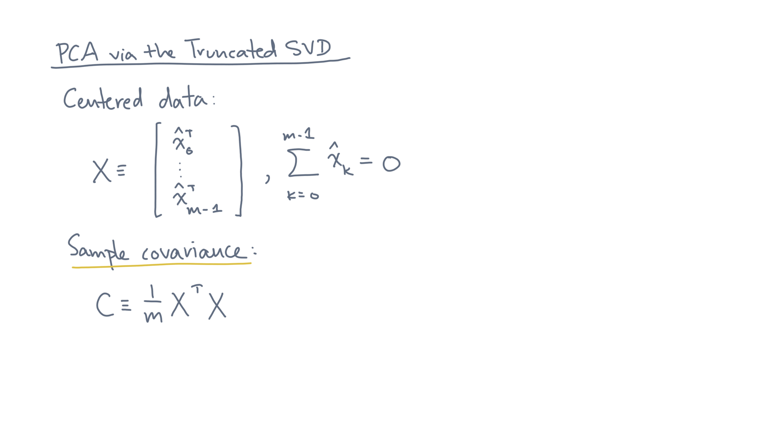
Notes:
From X, you can form the sample covariance matrix, C. @TODO: Show / highlight
It’s defined to be 1 over the number of observations m times X-transpose times X.

Slide 6
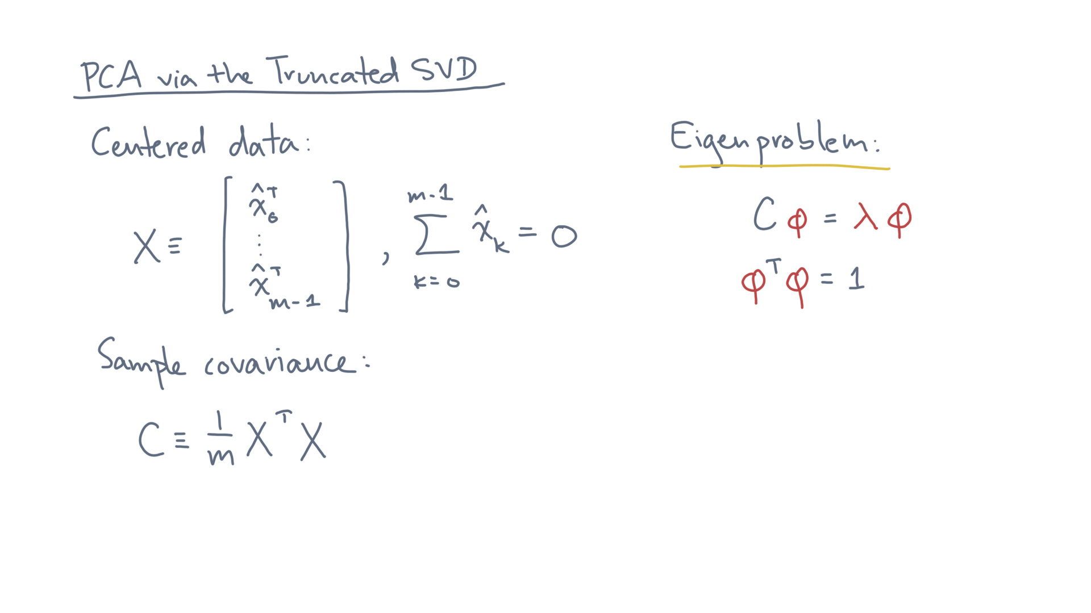
Notes:
The computational task is to solve an eigenproblem. @TODO: Show
That is, you want to compute an eigenvector, eigenvalue pair, denoted (phi, lambda), such that C times phi equals lambda phi.

Slide 7
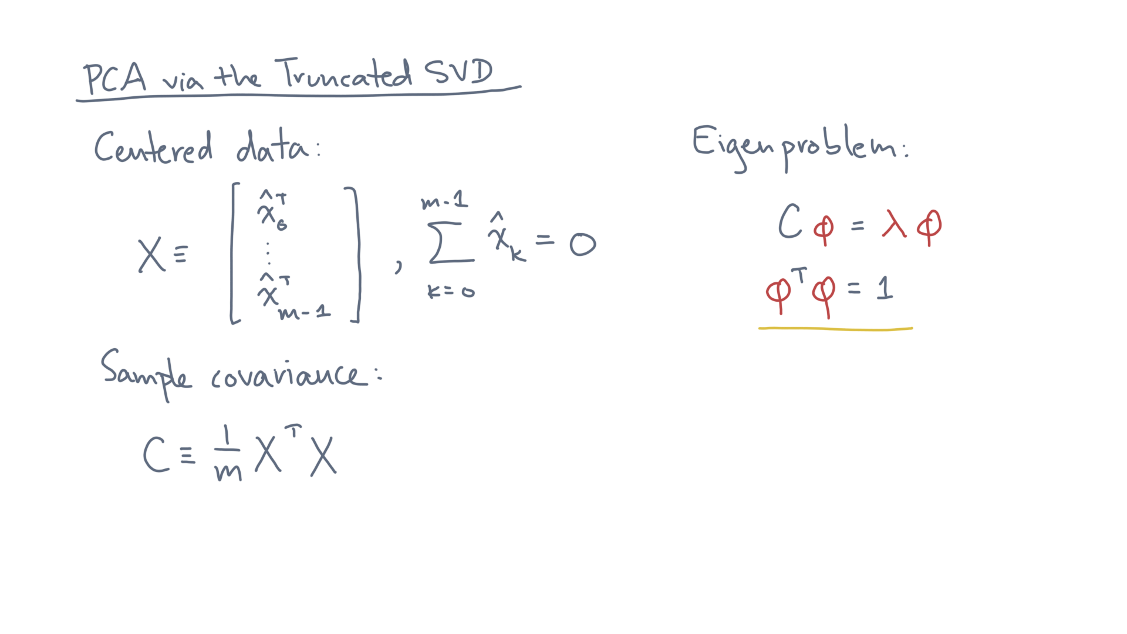
Notes:
In addition, the length of the eigenvector phi should equal one. @TODO: Show / highlight

Slide 8
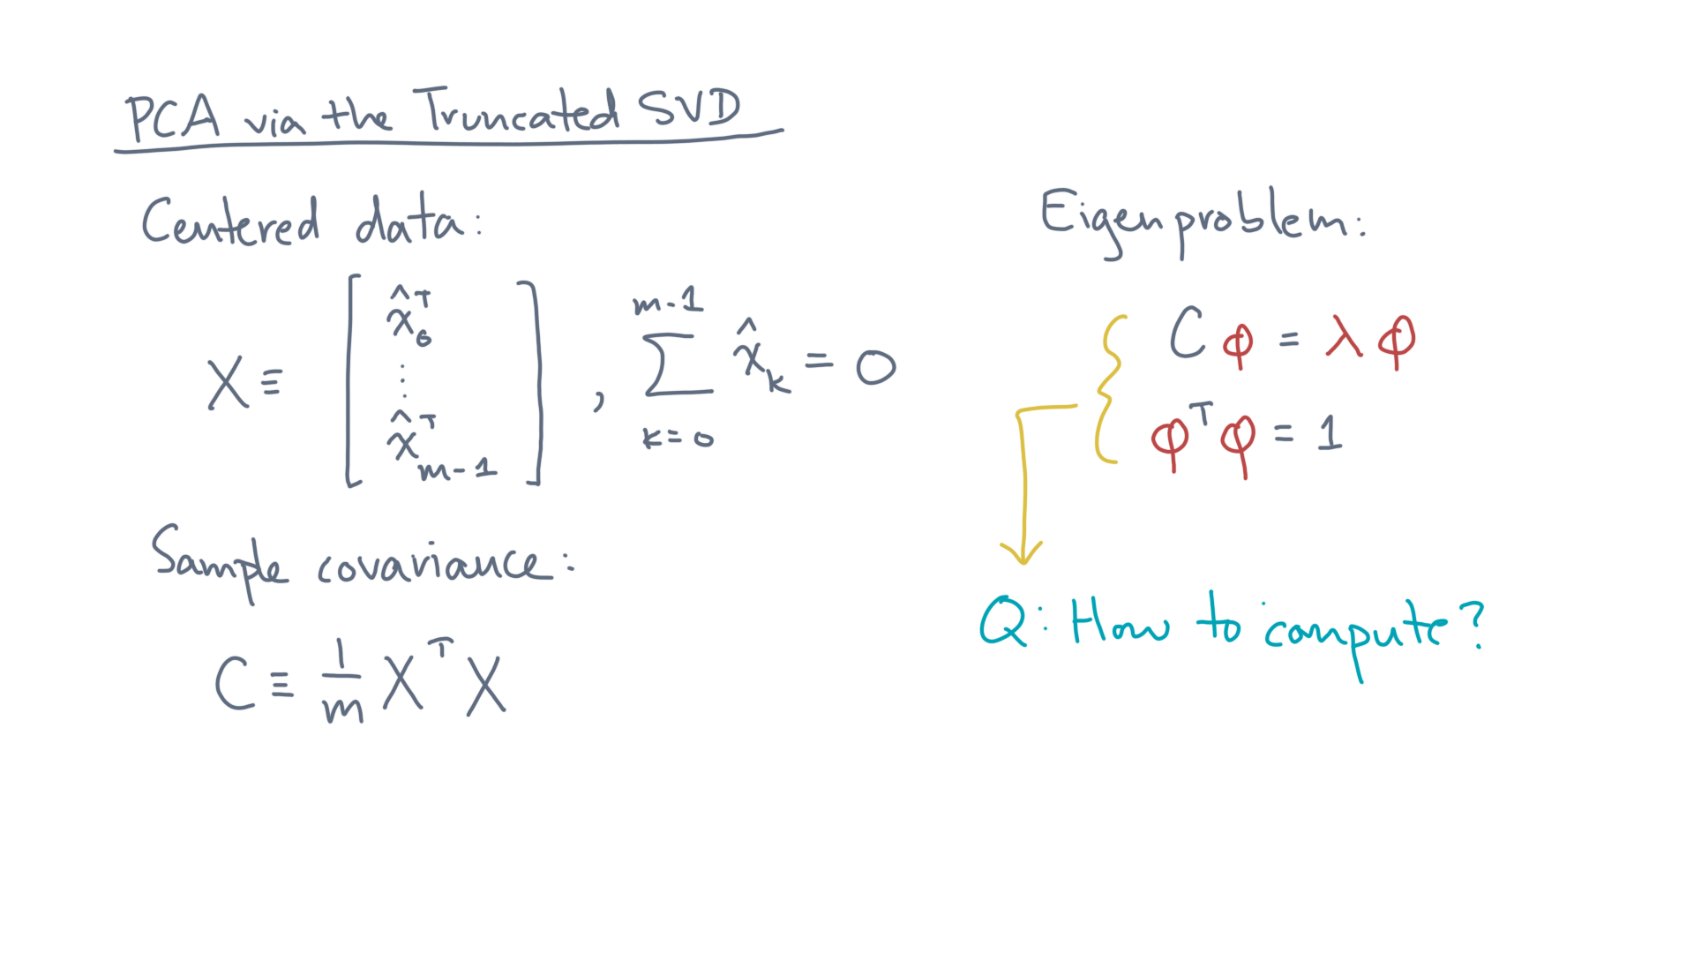
Notes:
Calculating eigenpairs on a computer is actually a somewhat tricky business, but luckily there are canned methods. @TODO: Write: How to compute?

Slide 9
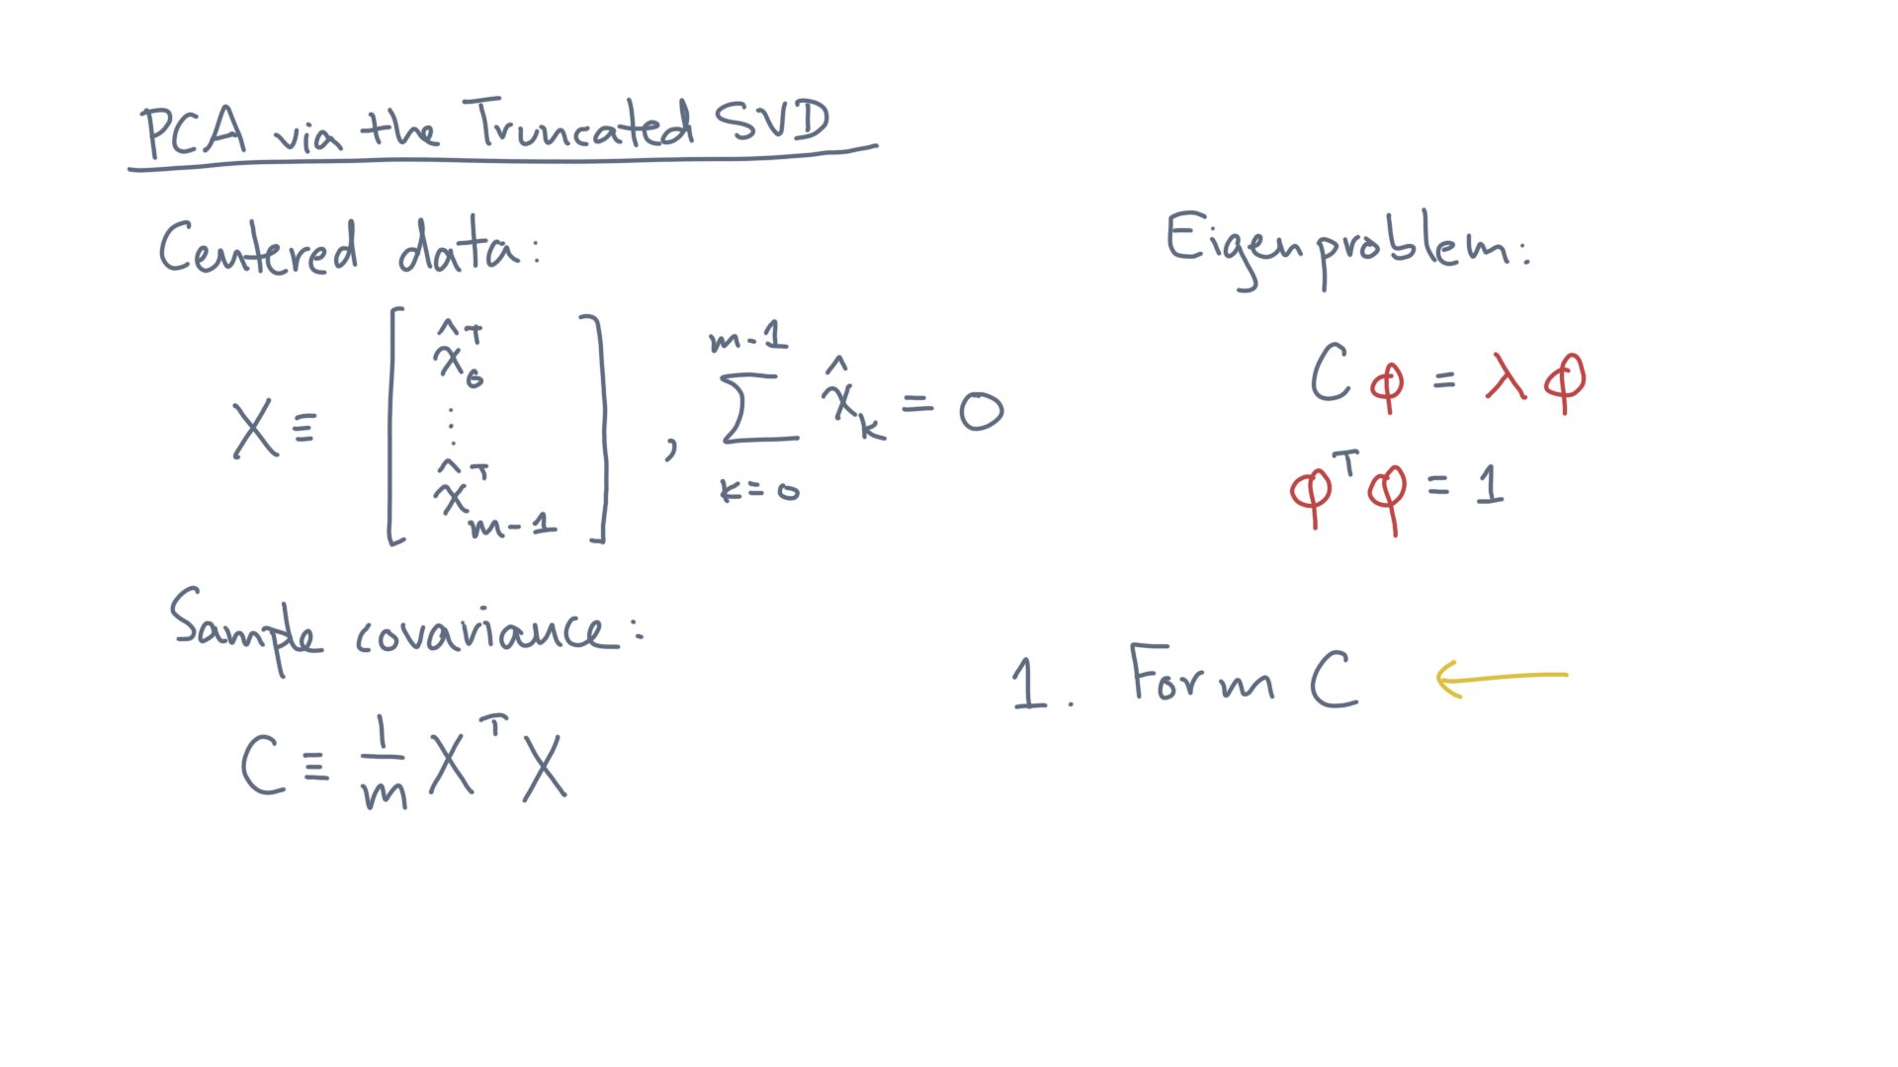
Notes:
So you might start by forming C. @TODO: Write step 1

Slide 10
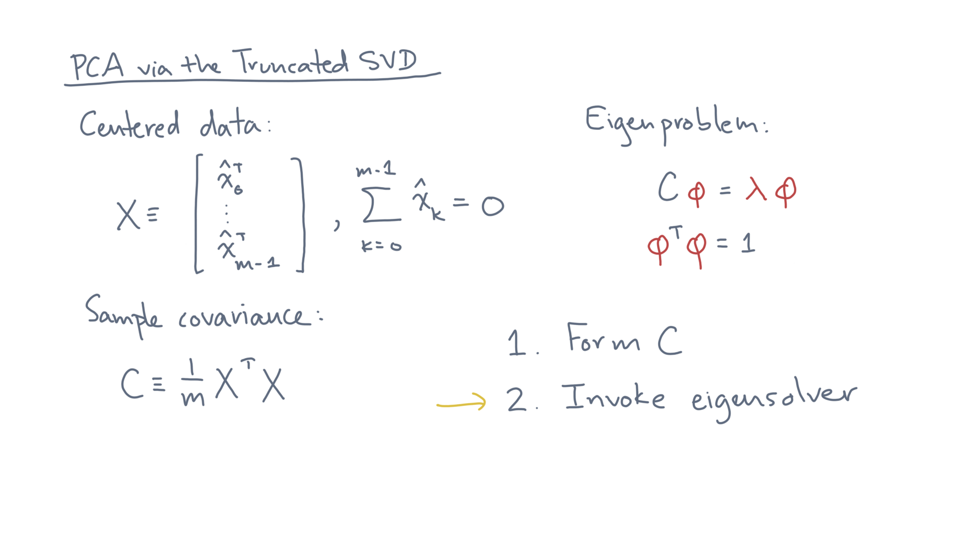
Notes:
And then feed that into an eigensolver. @TODO: Highlight step 2

Slide 11
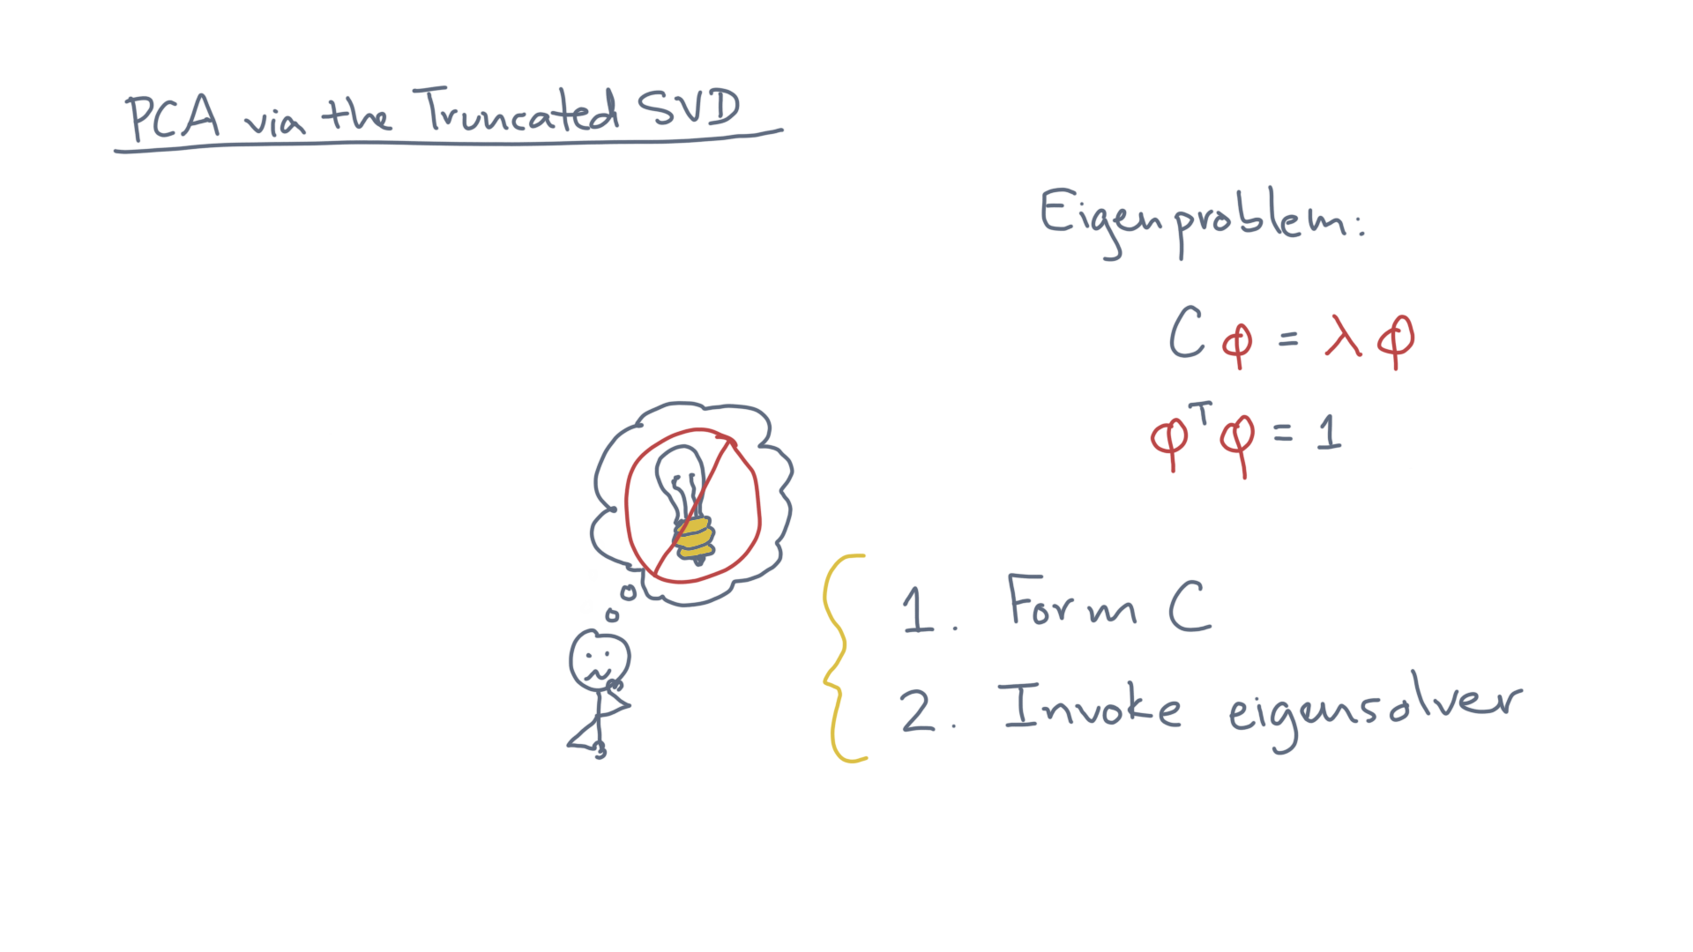
Notes:
But this method is not a good idea. @TODO: Draw ”bad idea” image
Can you explain why?
As a hint, what can you say about the numerical properties of C compared to X?

Slide 12
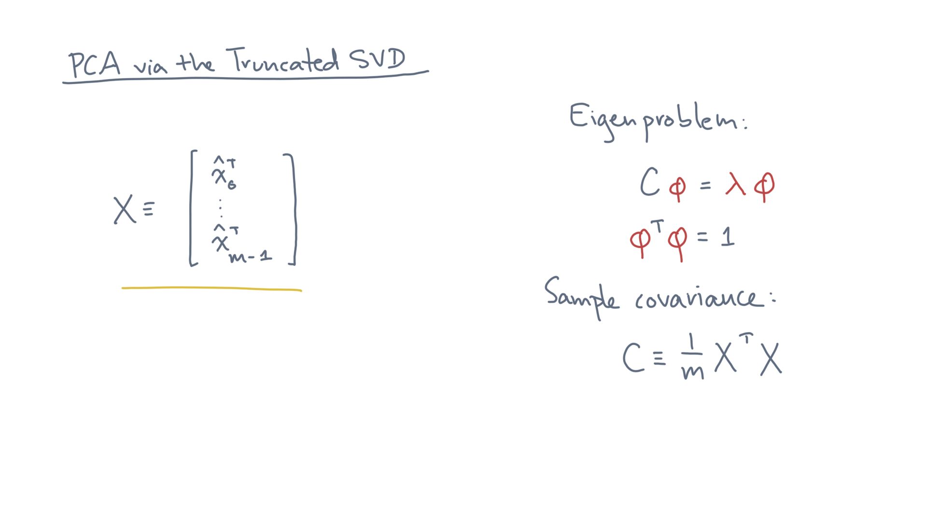
Notes:
So what’s an alternative? @TODO: Erase
Let’s start by looking just at X.

Slide 13
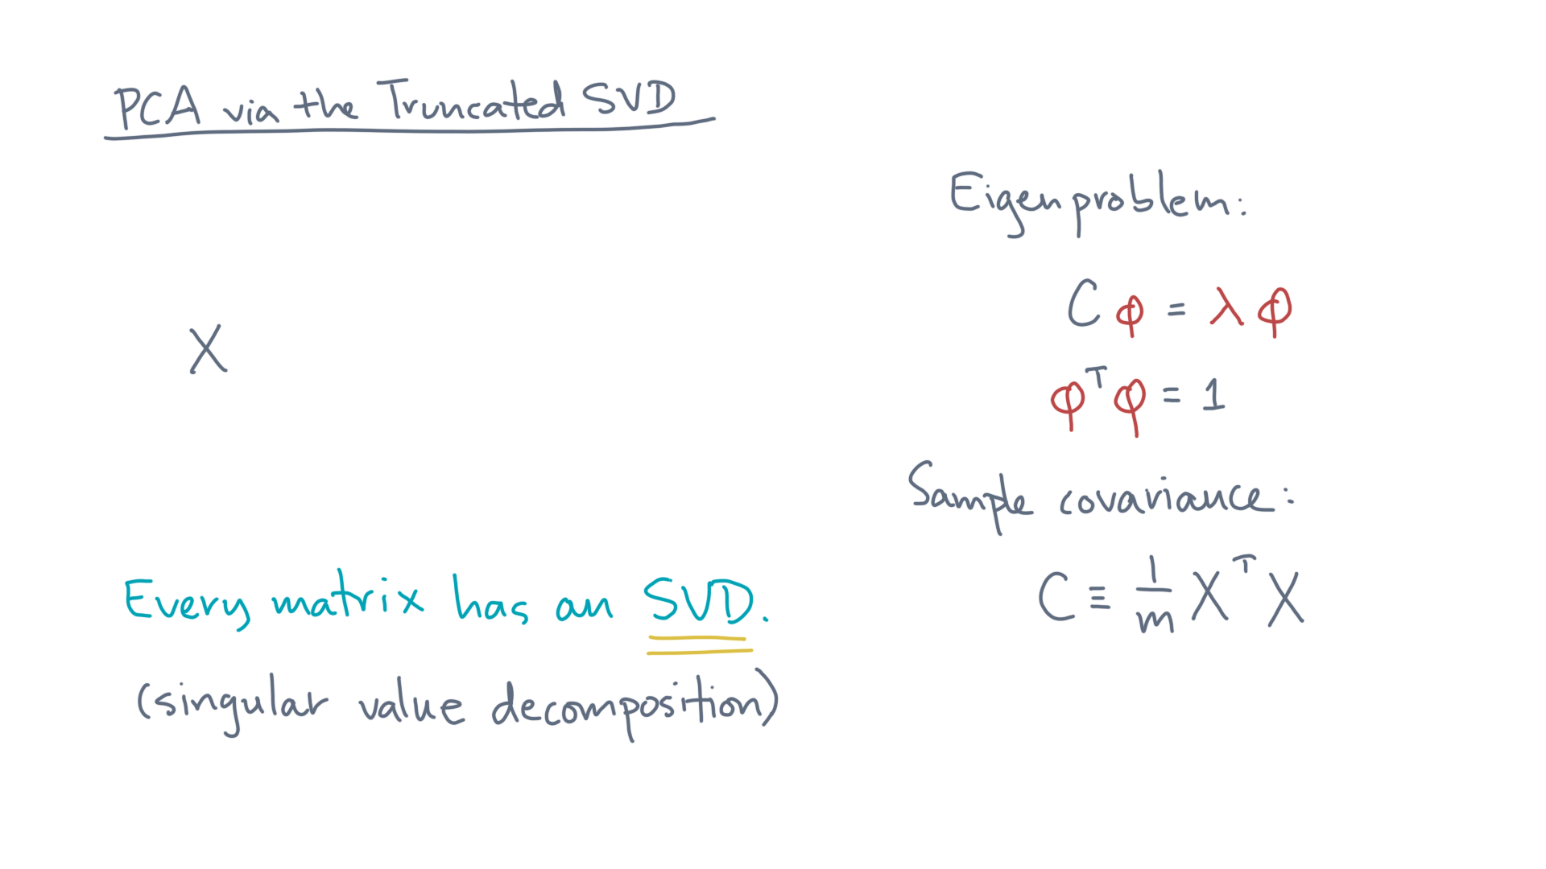
Notes:
Here is a fact from linear algebra: @TODO: Show text
Every matrix X has a *singular value decomposition*, or SVD.

Slide 14
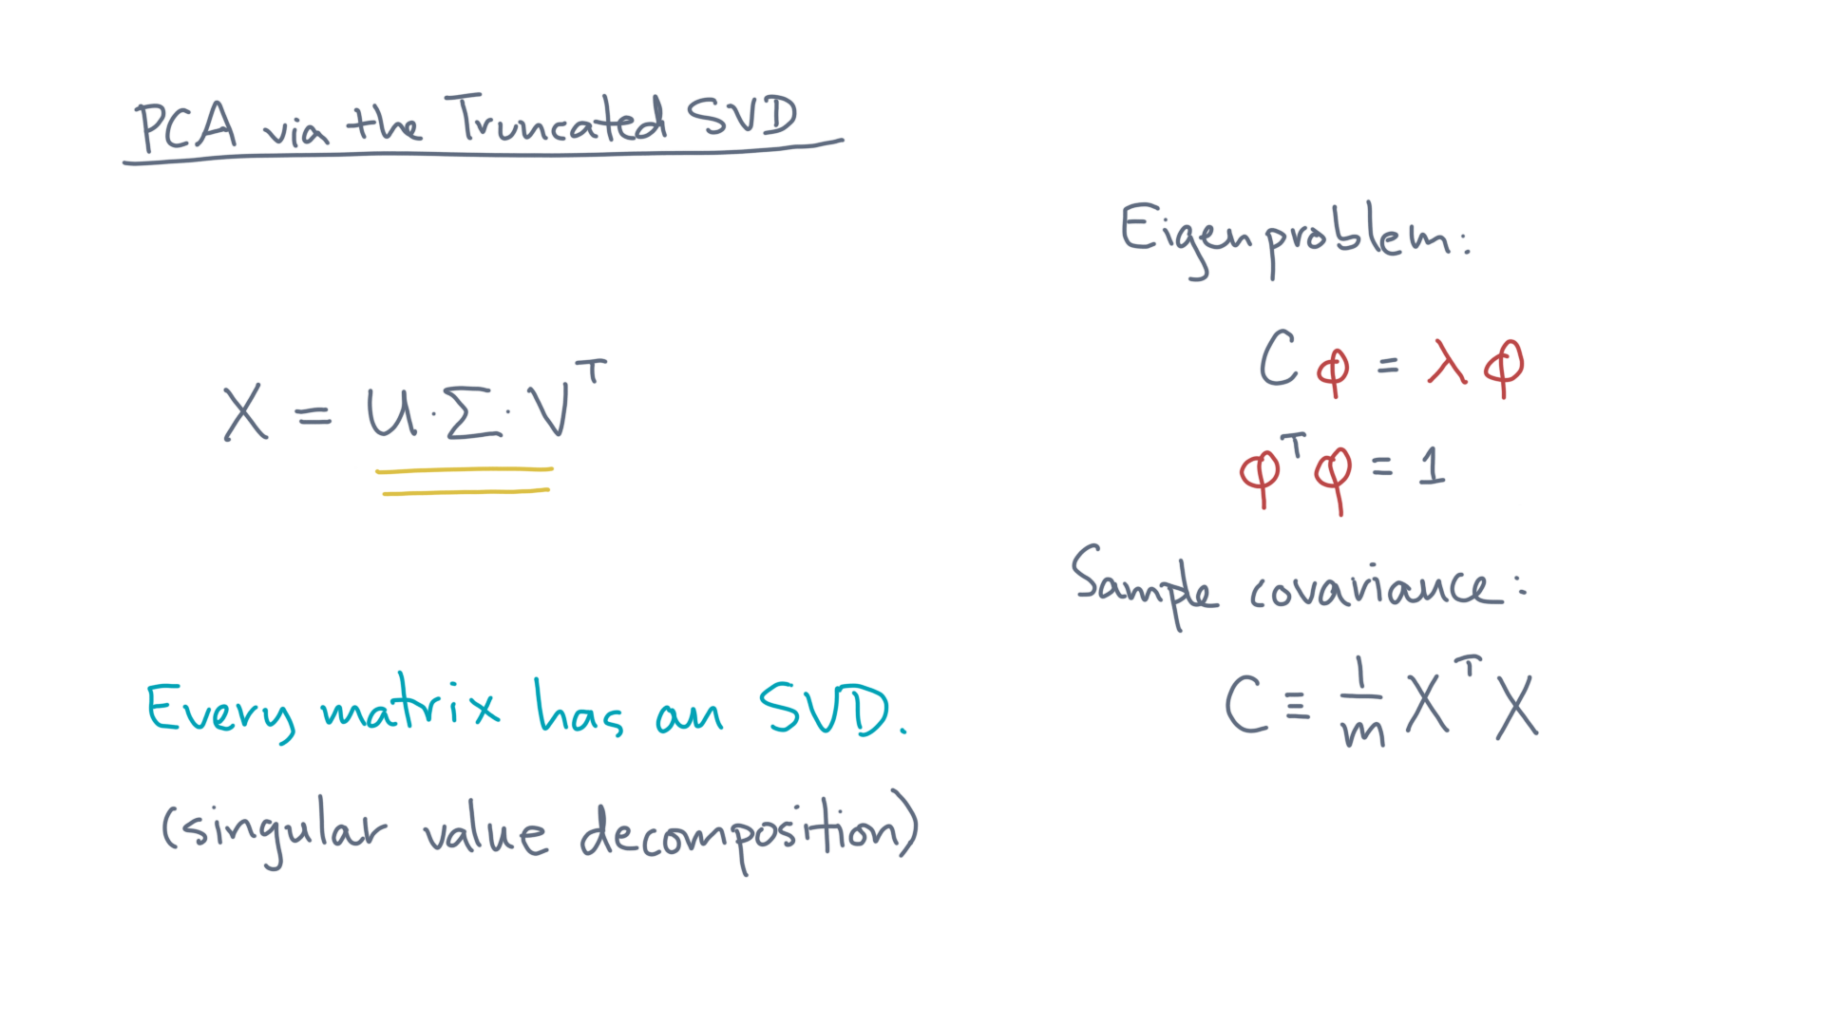
Notes:
That means you can factor X into the product of three matrices: @TODO HIGHLIGHT
U times Sigma times V-transpose.

Slide 15
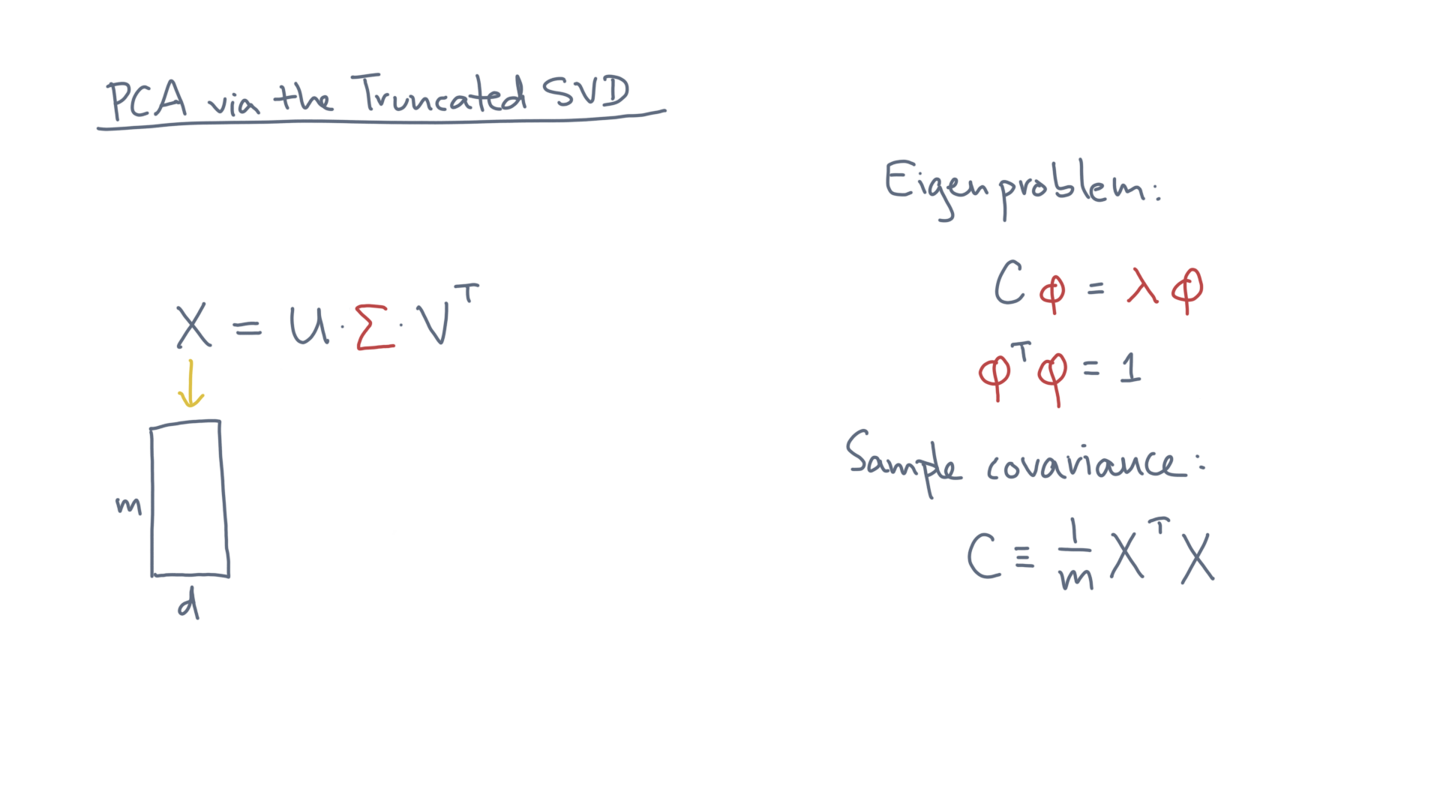
Notes:
Assume X is m x d, as our convention has been for data matrices. @TODO: Unhighlight

Slide 16
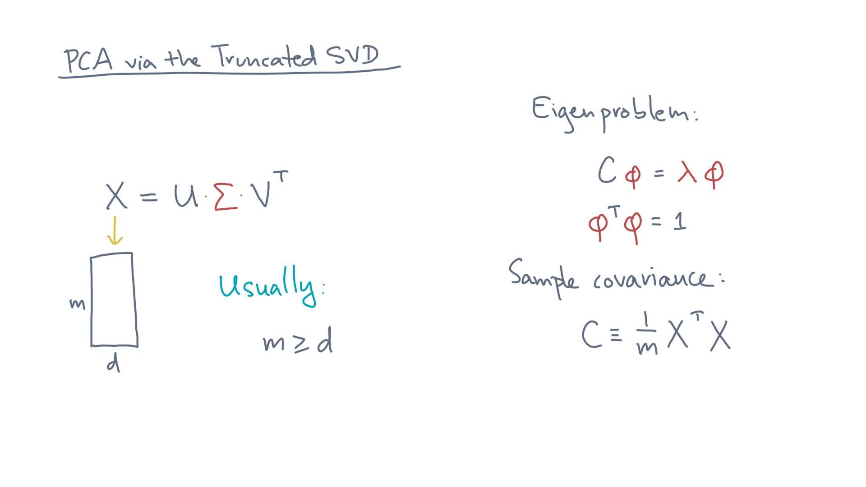
Notes:
Usually, for data matrices, m is greater than or equal to d. @TODO: Write
However, let’s consider a more general case.

Slide 17
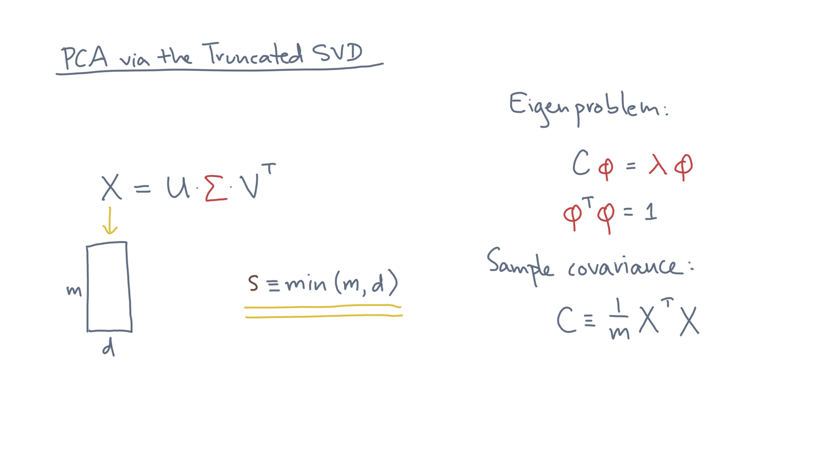
Notes:
In this case, let s be the smaller of the two values, m or d. @TODO: Write

Slide 18
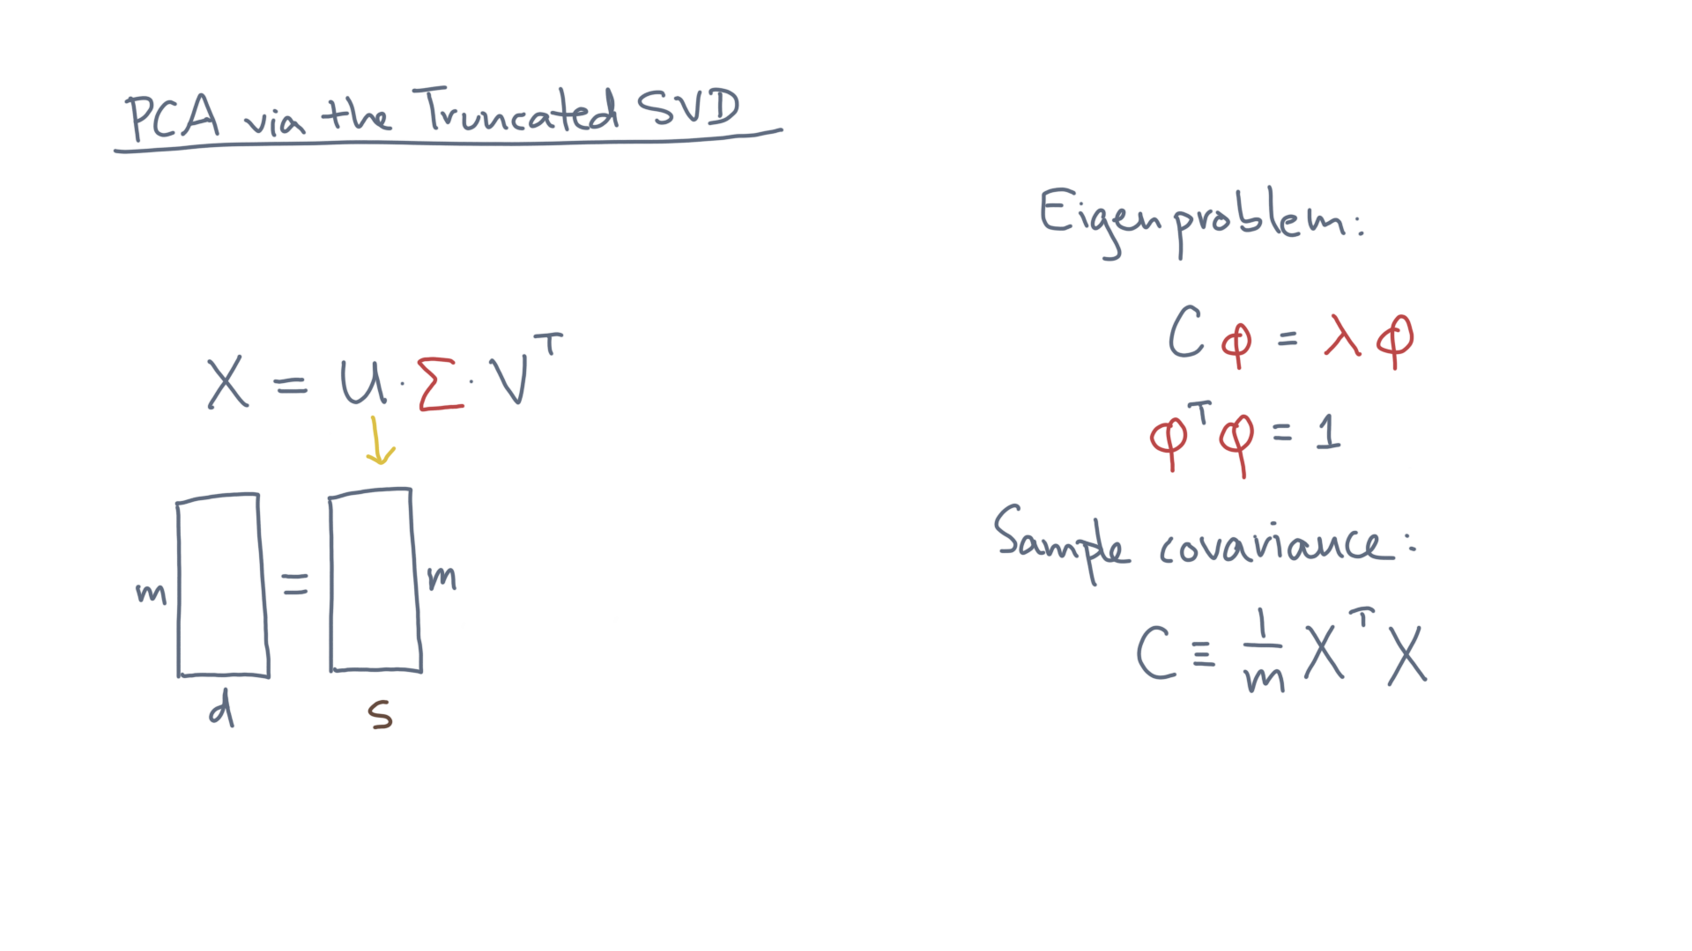
Notes:
Then U is an m by s matrix.

Slide 19
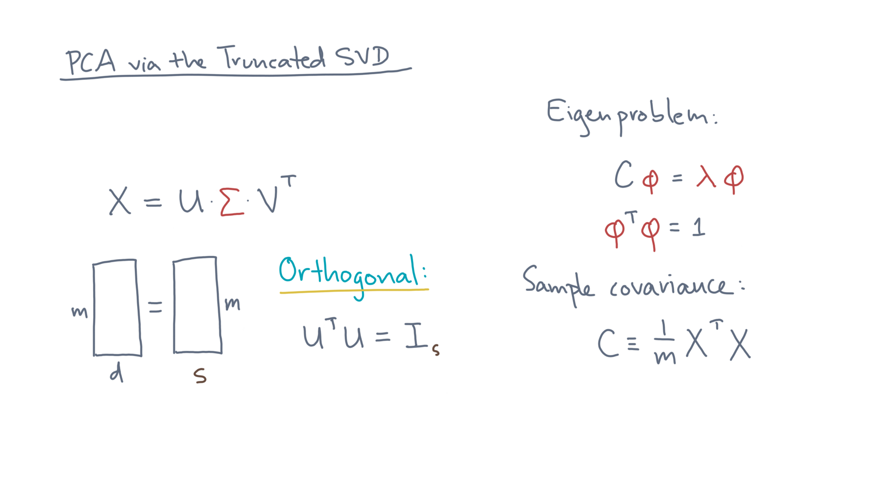
Notes:
It’s also *orthogonal.*
That means U-transpose U is the s by s identity matrix.

Slide 20
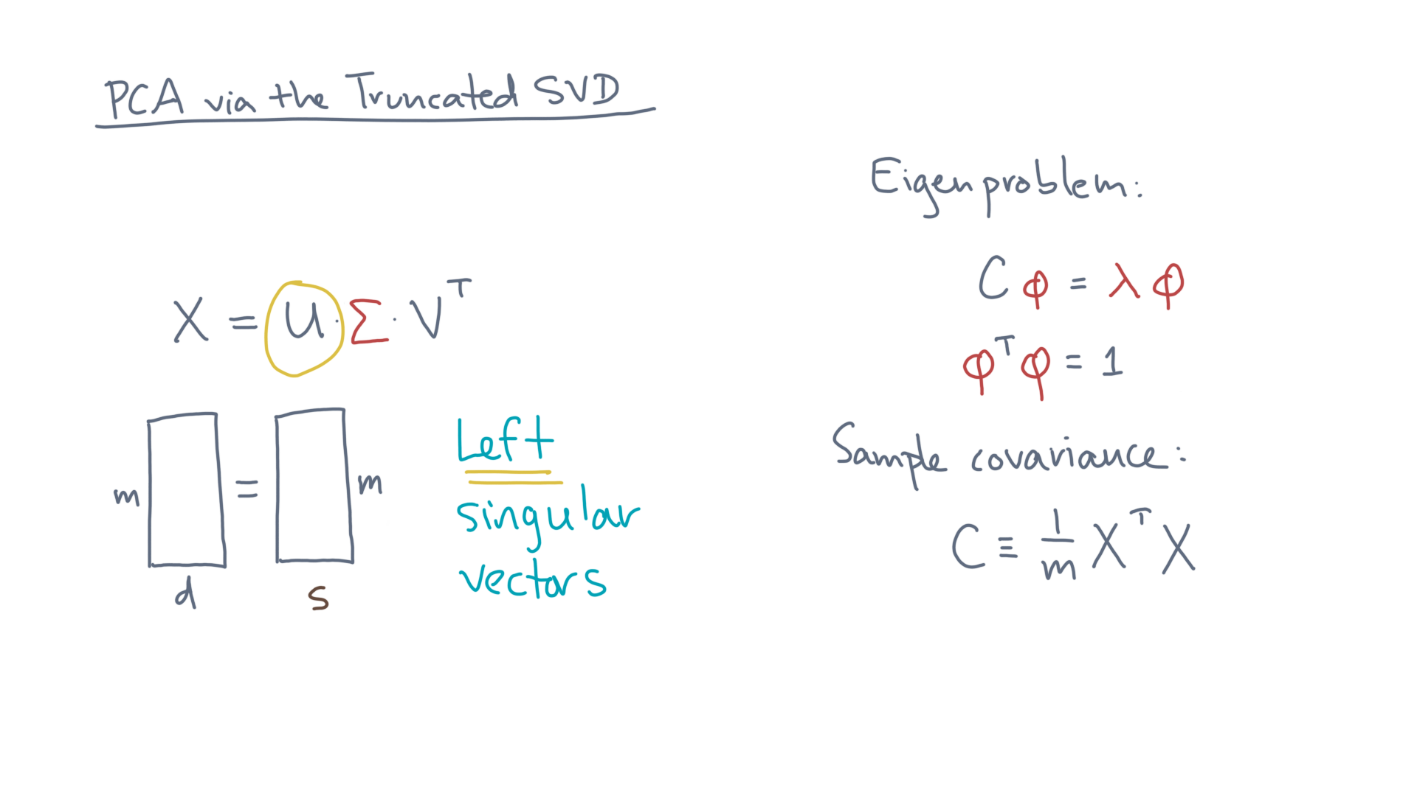
Notes:
The columns of U are the left singular vectors. @TODO: Show highlight

Slide 21
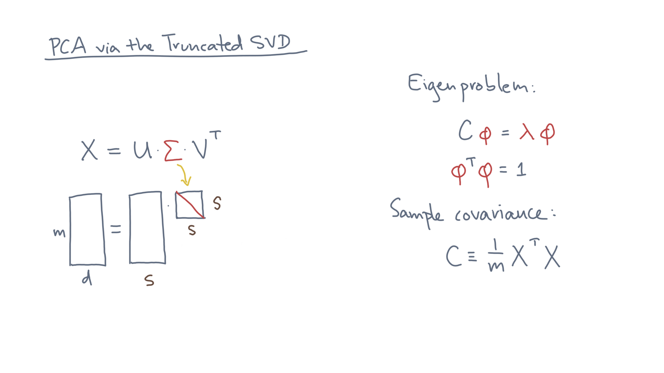
Notes:
The matrix Sigma is a s by s diagonal matrix.

Slide 22
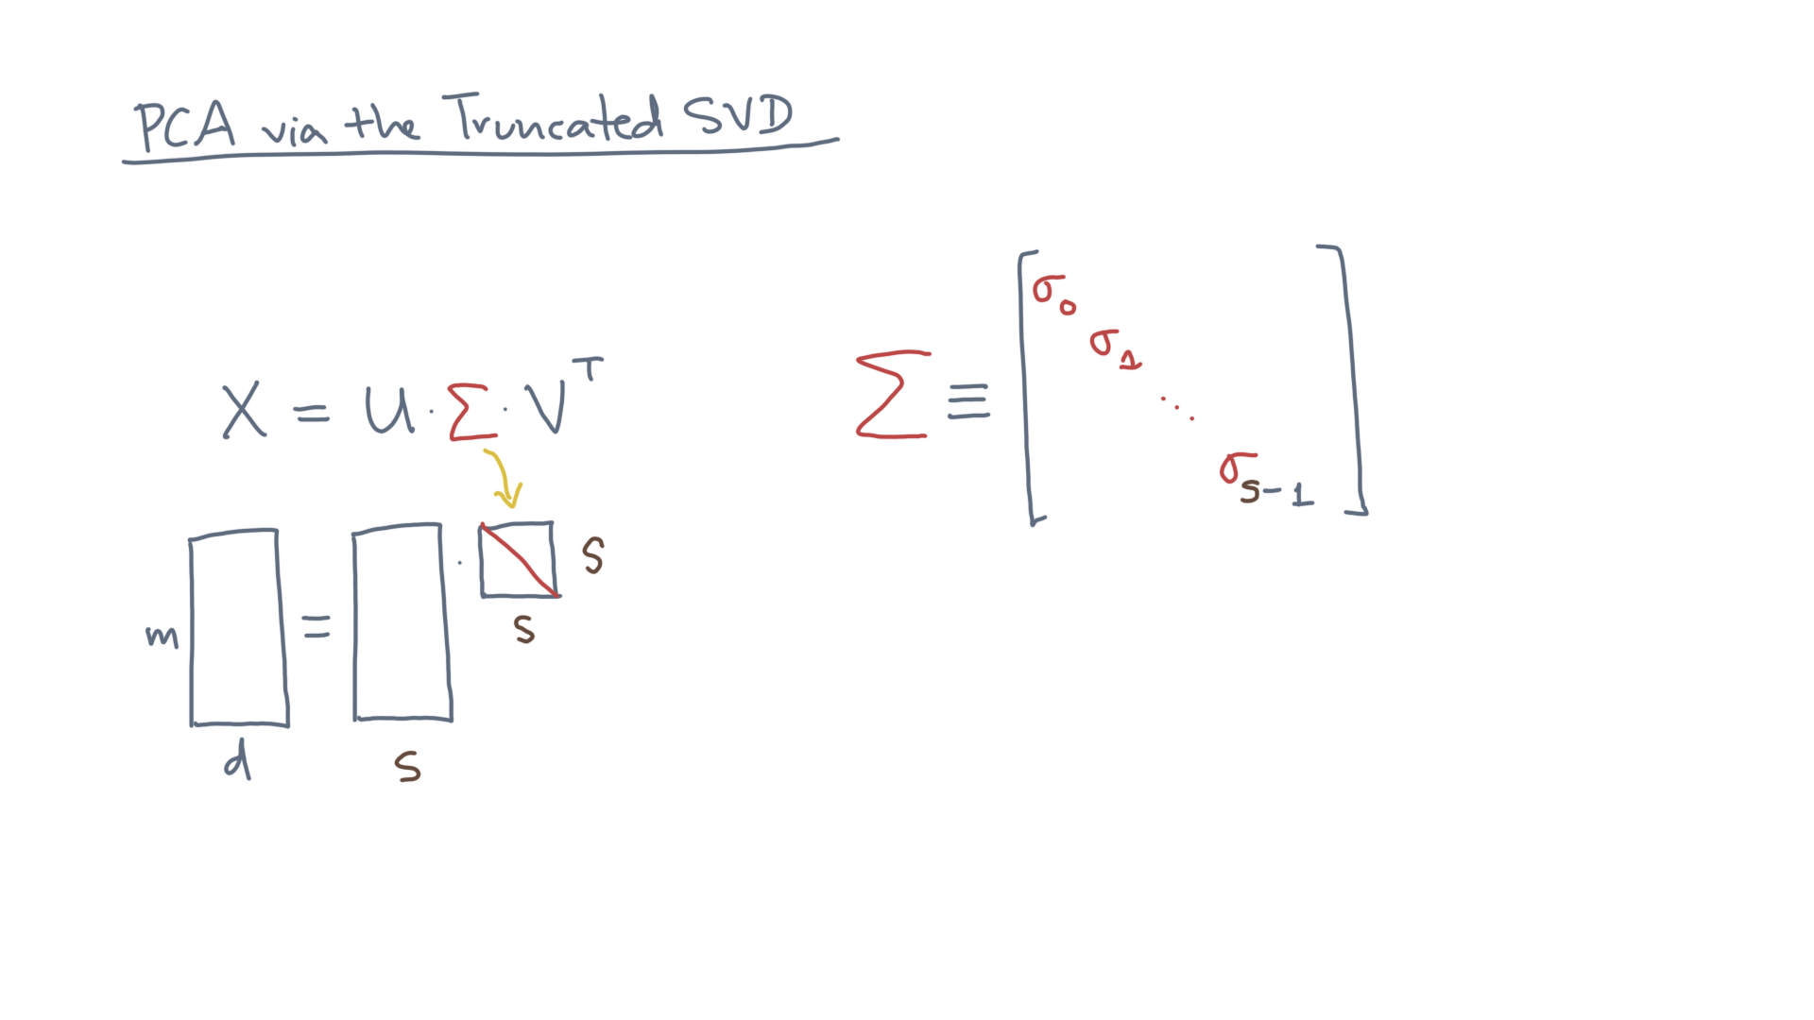
Notes:
Let’s name these entries sigma_0, sigma_1, and so on, up to sigma s-1.

Slide 23
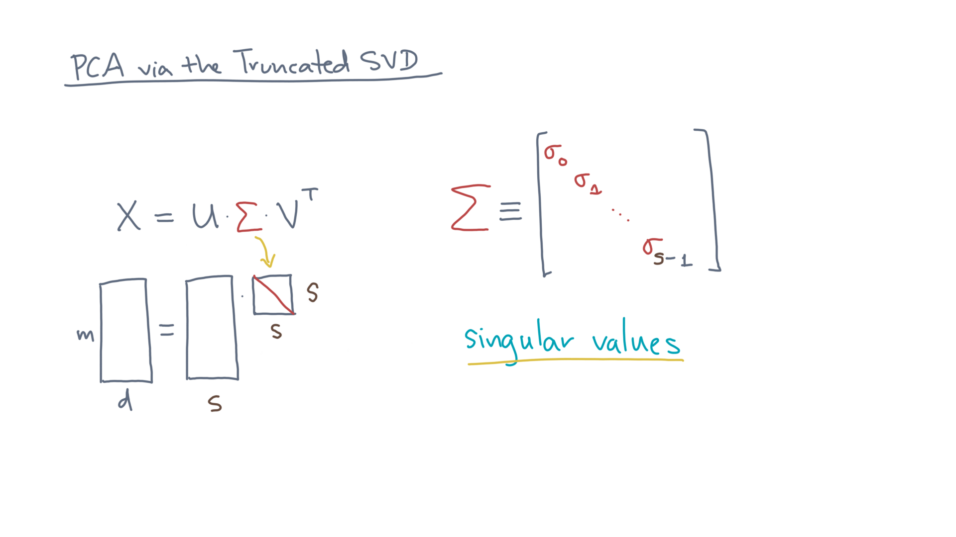
Notes:
They are called the singular values of X. @TODO: Show term

Slide 24
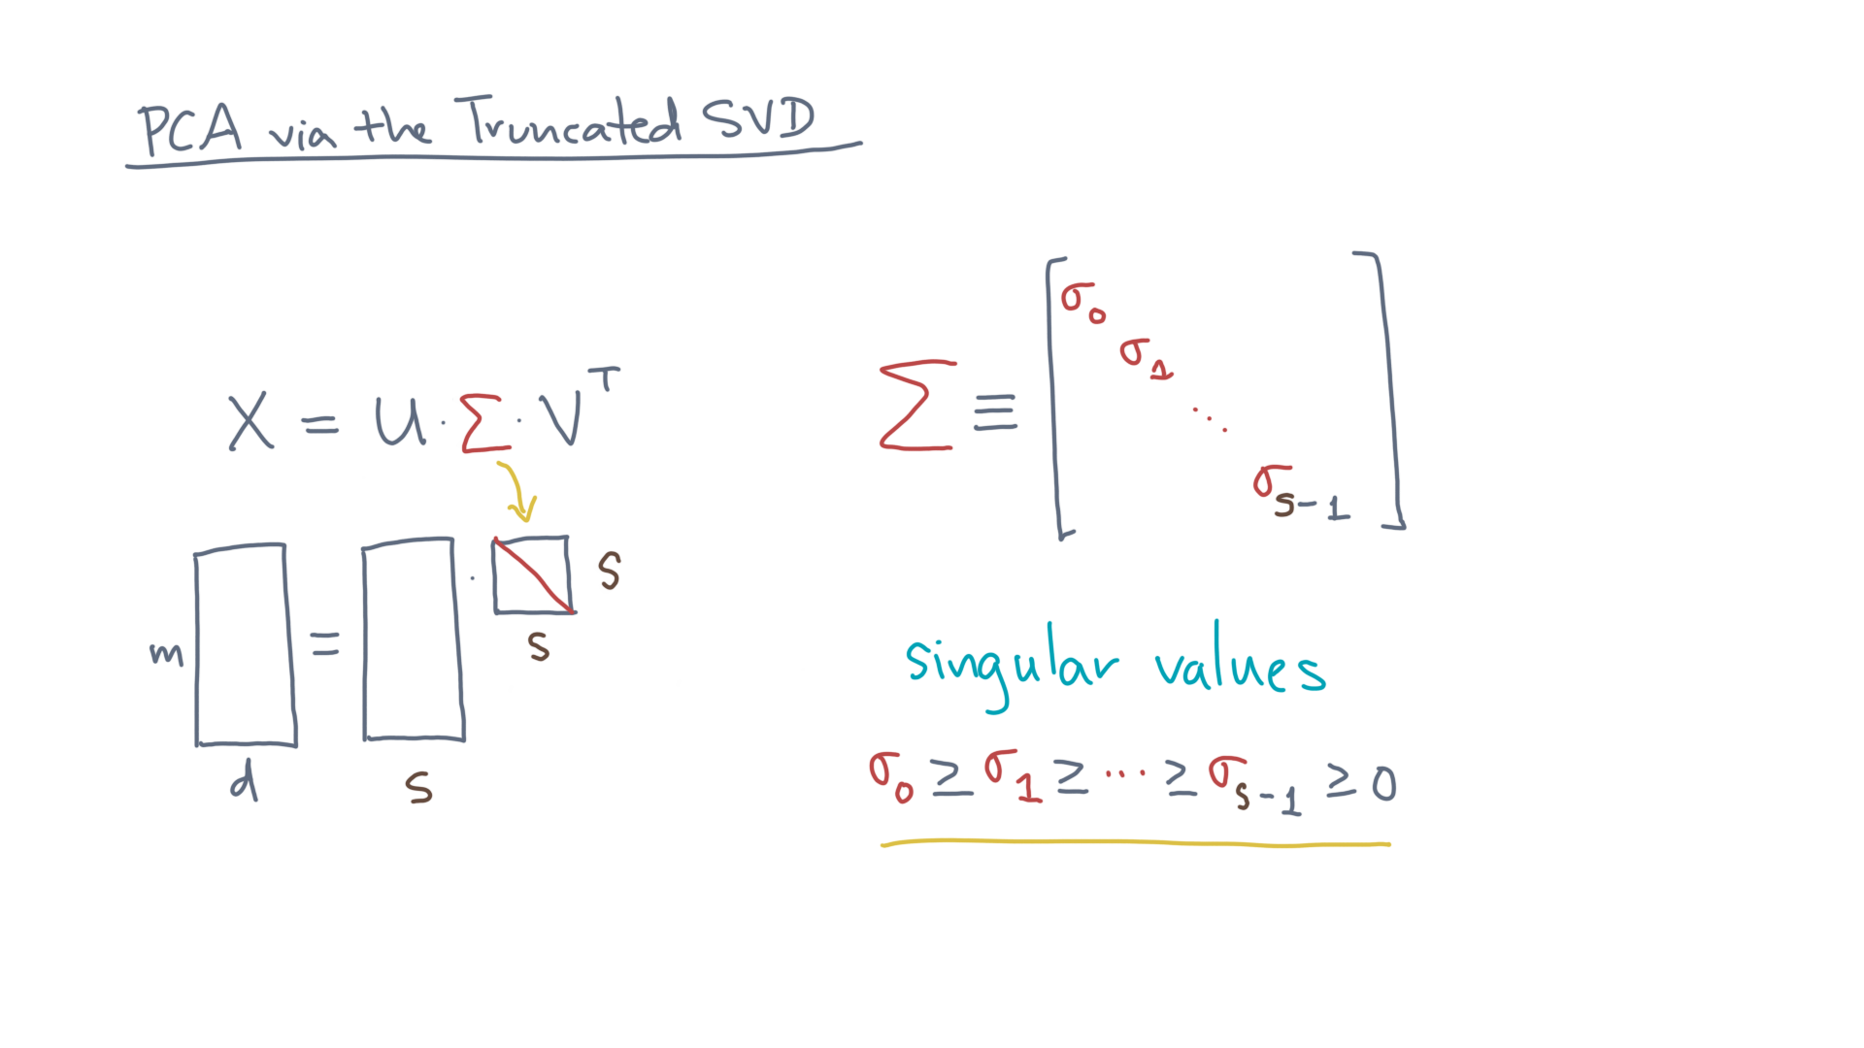
Notes:
In addition, let’s assume they are ordered in descending order, and non-negative. @TODO: Highlight

Slide 25
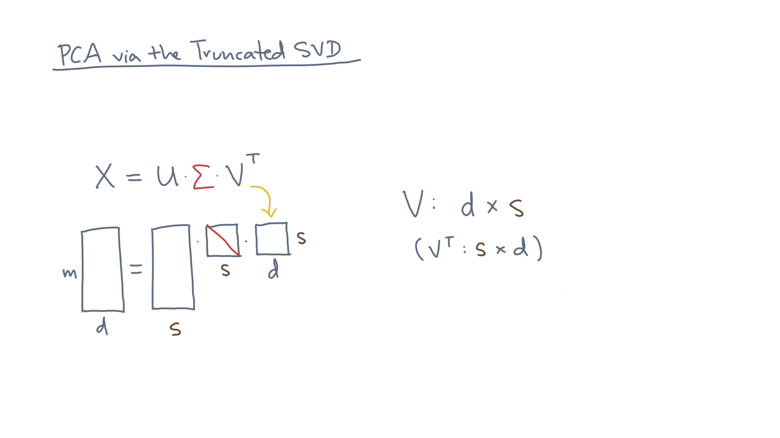
Notes:
Lastly, let V be a d by s matrix.
That means its transpose is s by d, as illustrated here.

Slide 26
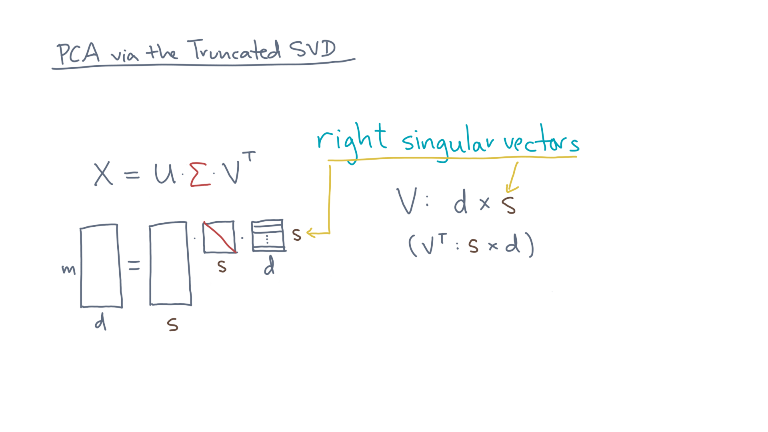
Notes:
The columns of V – meaning the *rows* of V-transpose – are called the right singular vectors.

Slide 27
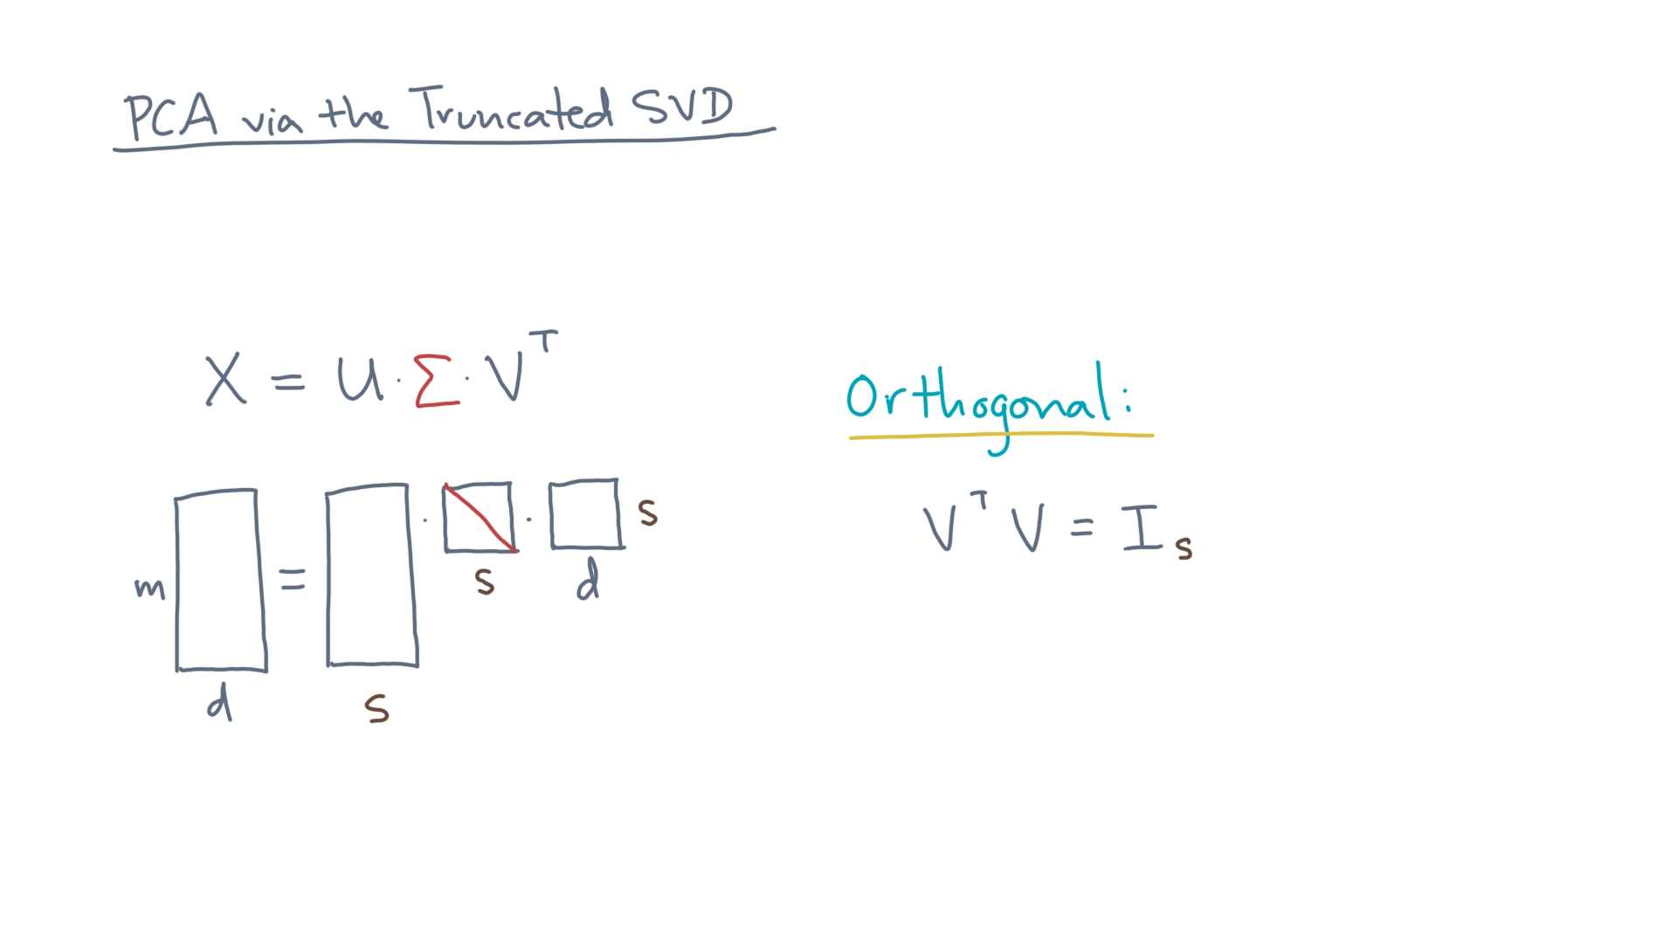
Notes:
Like the left singular vectors, the right ones are also orthogonal.

Slide 28
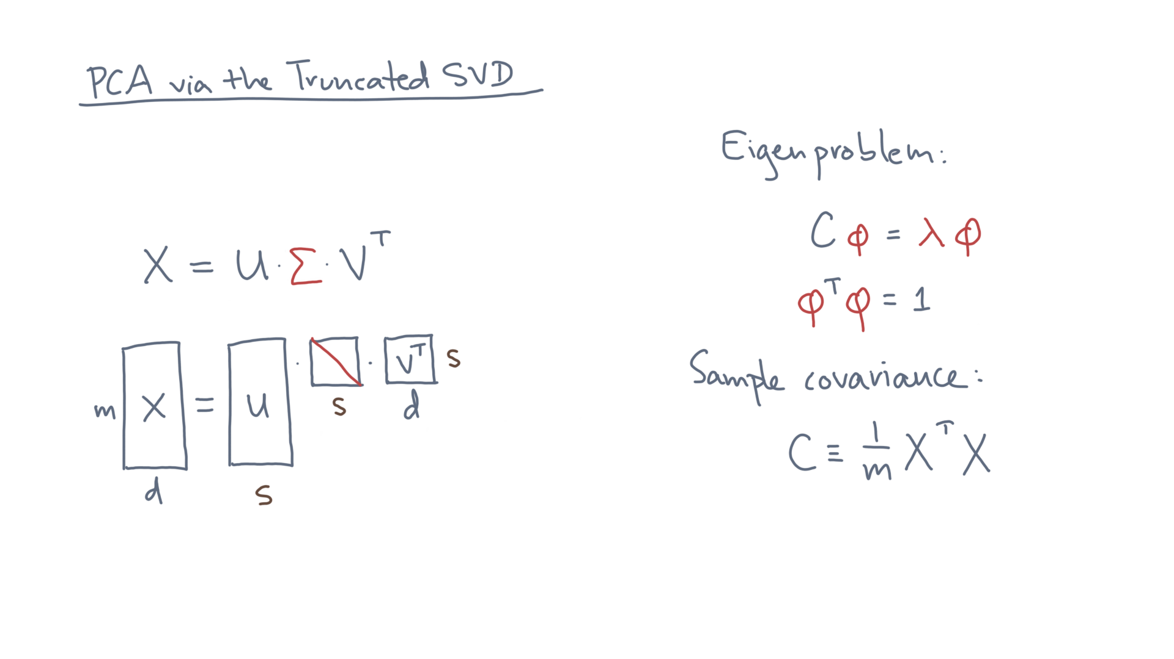
Notes:
Now suppose I give you the SVD of X. @TODO: Clear
How do you solve the eigenproblem?

Slide 29
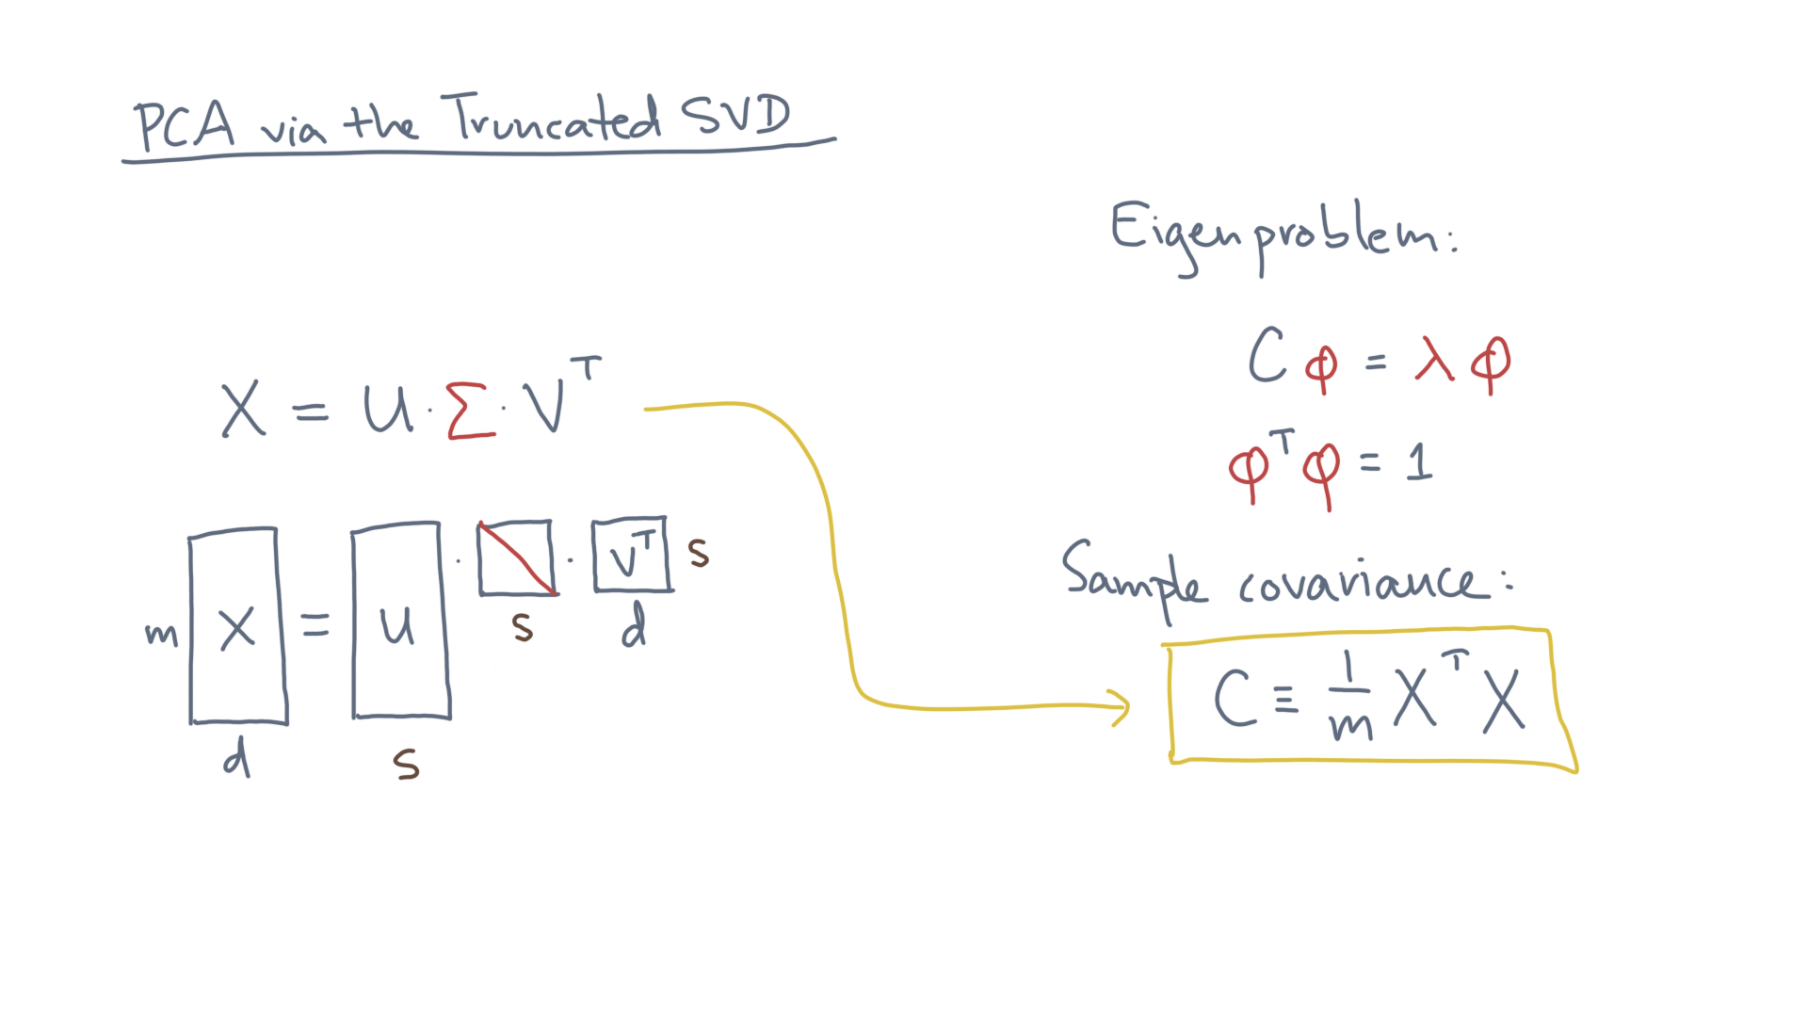
Notes:
Start with the definition of the covariance and plug in the SVD.

Slide 30
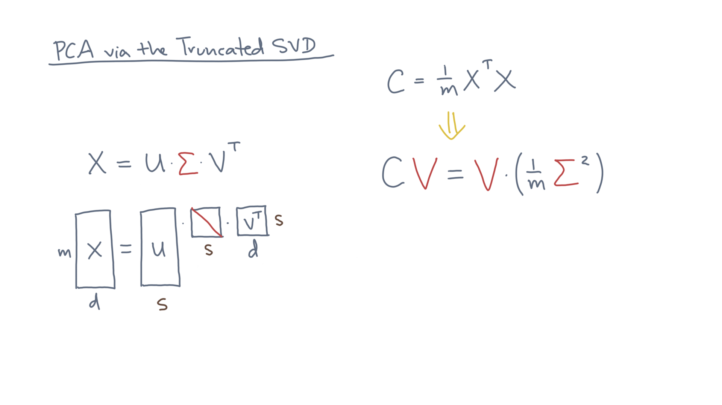
Notes:
After simplifying, here is what you get.
C times V equals V times Sigma-squared divided by m.

Slide 31
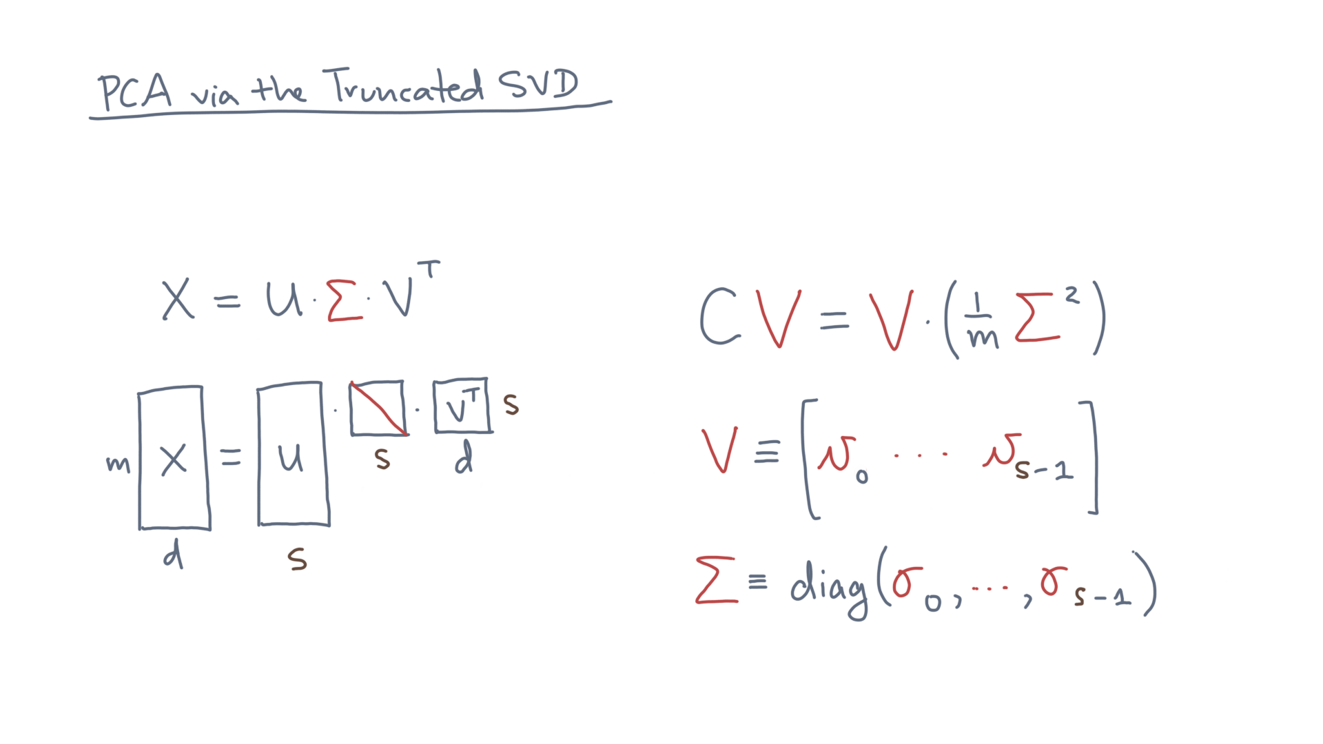
Notes:
Consider the columns of V, v-zero through v-s-minus-one, and the singular values, sigma-zero through sigma-s-minus-one.

Slide 32
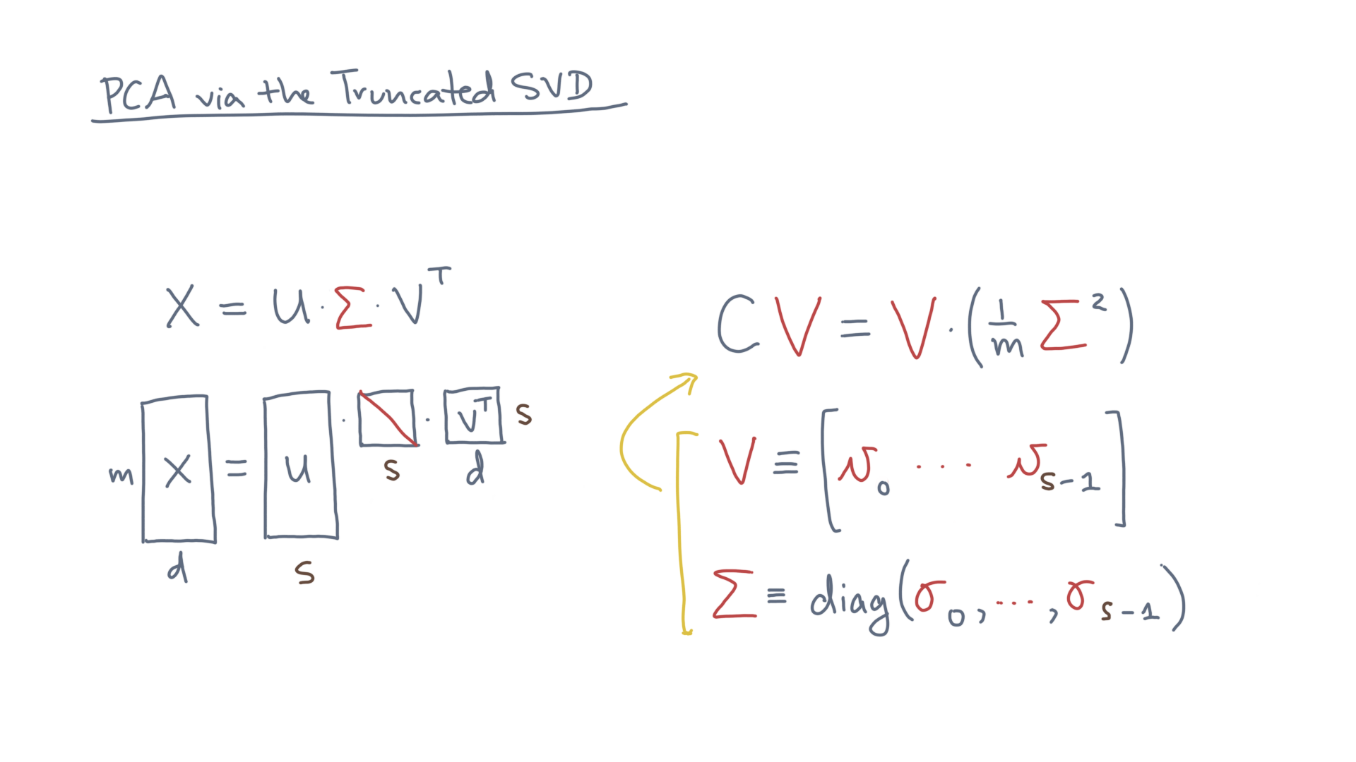
Notes:
What do they imply about this system?

Slide 33
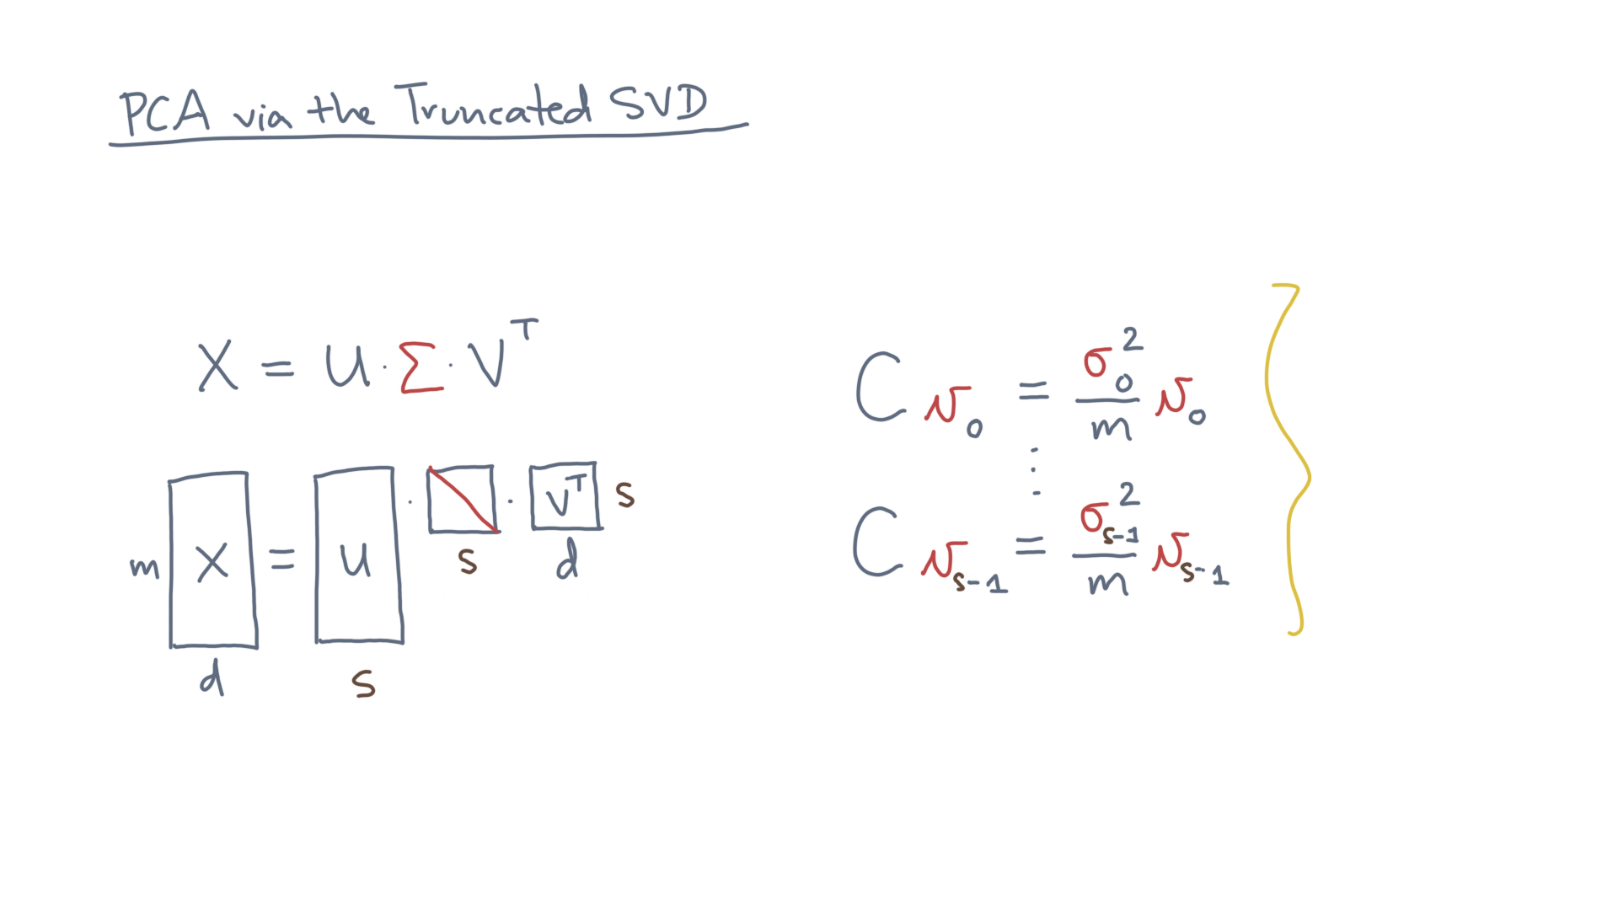
Notes:
It’s equivalent to s independent equations. @TODO: Show
And what do you notice about these?

Slide 34
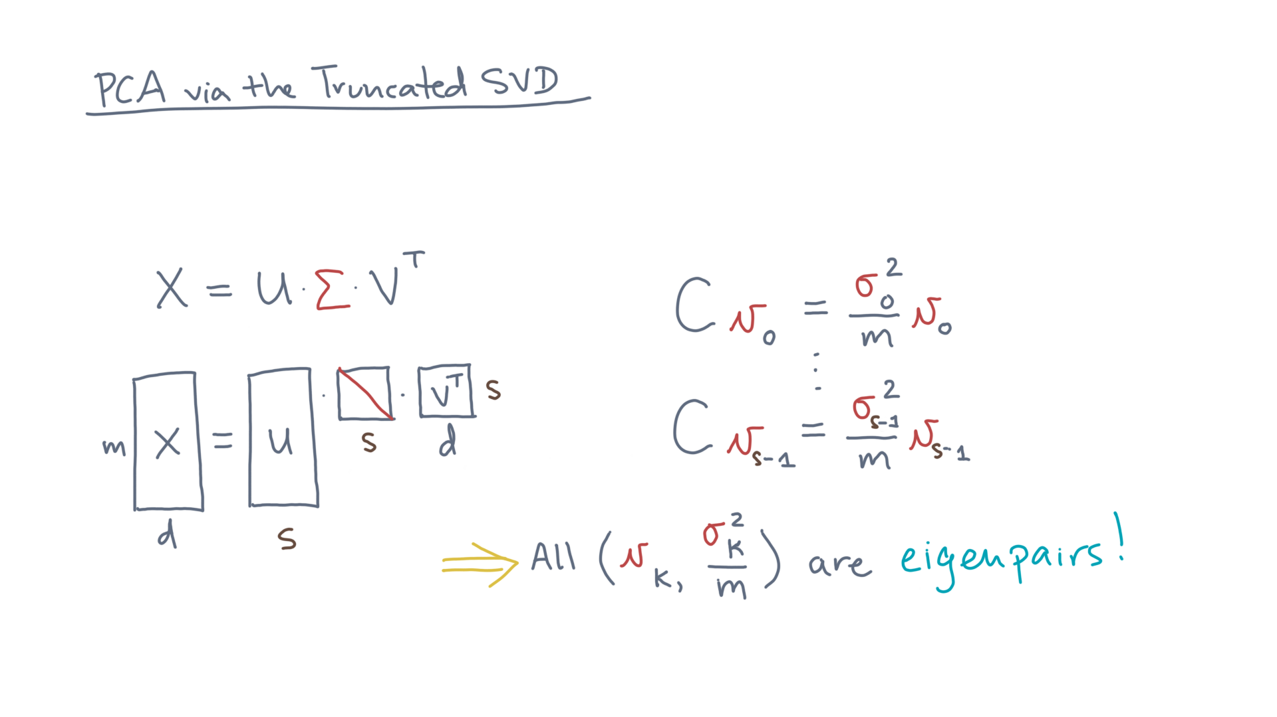
Notes:
That’s right, they are all eigenpairs!

Slide 35
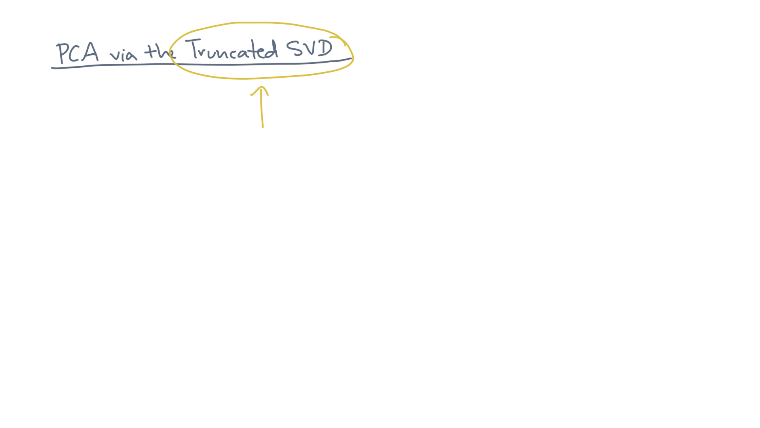
Notes:
If you are following so far, then we just need one more step to finish the compression problem, which is “truncation” of the SVD.
Start by viewing the SVD in this equivalent form.

Slide 36
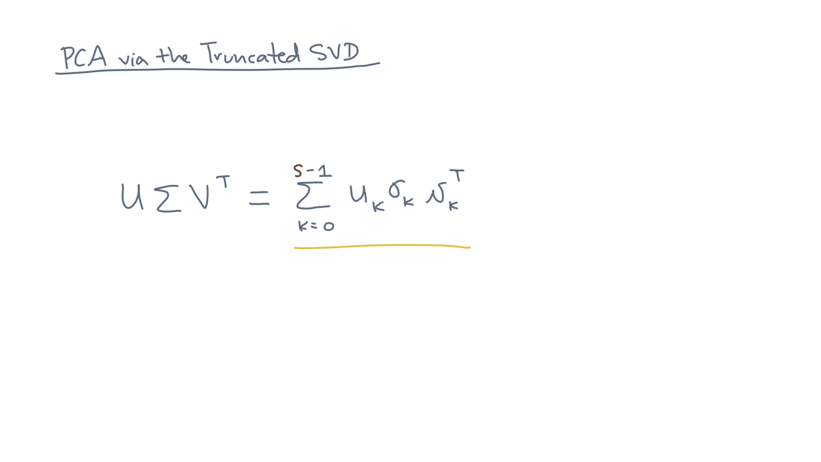
Notes:
For all singular values and vectors indexed by k, for k from zero to s-minus-one, the sum of u-kay times sigma-kay times v-kay-transpose.

Slide 37
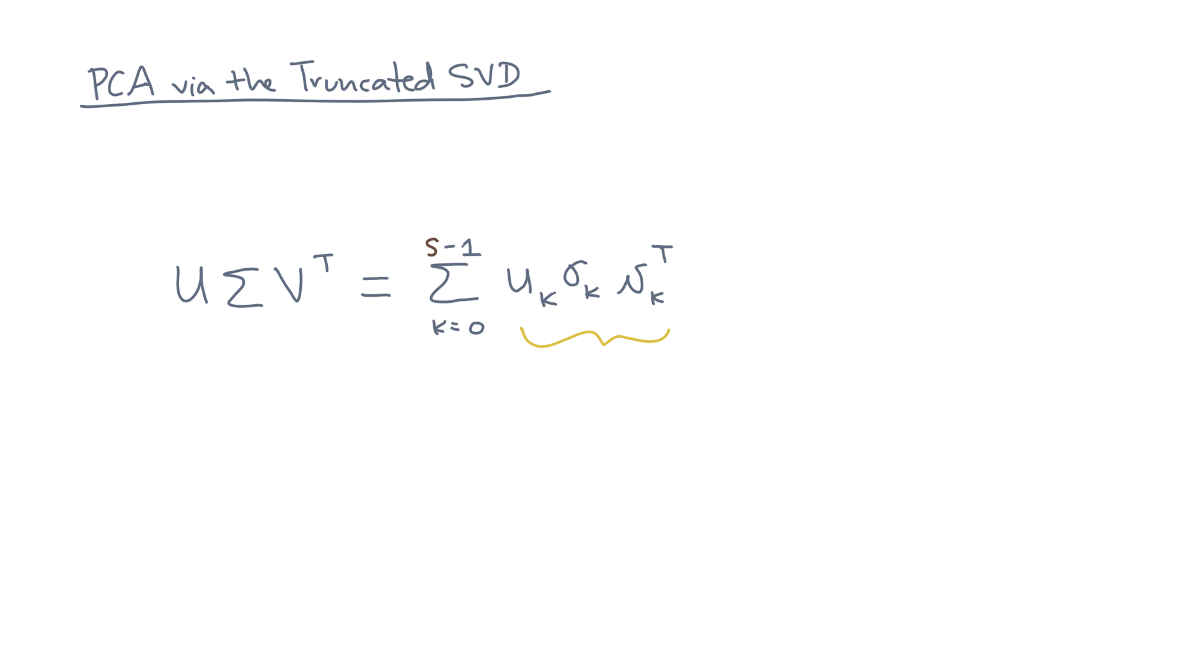
Notes:
Now consider each term.

Slide 38
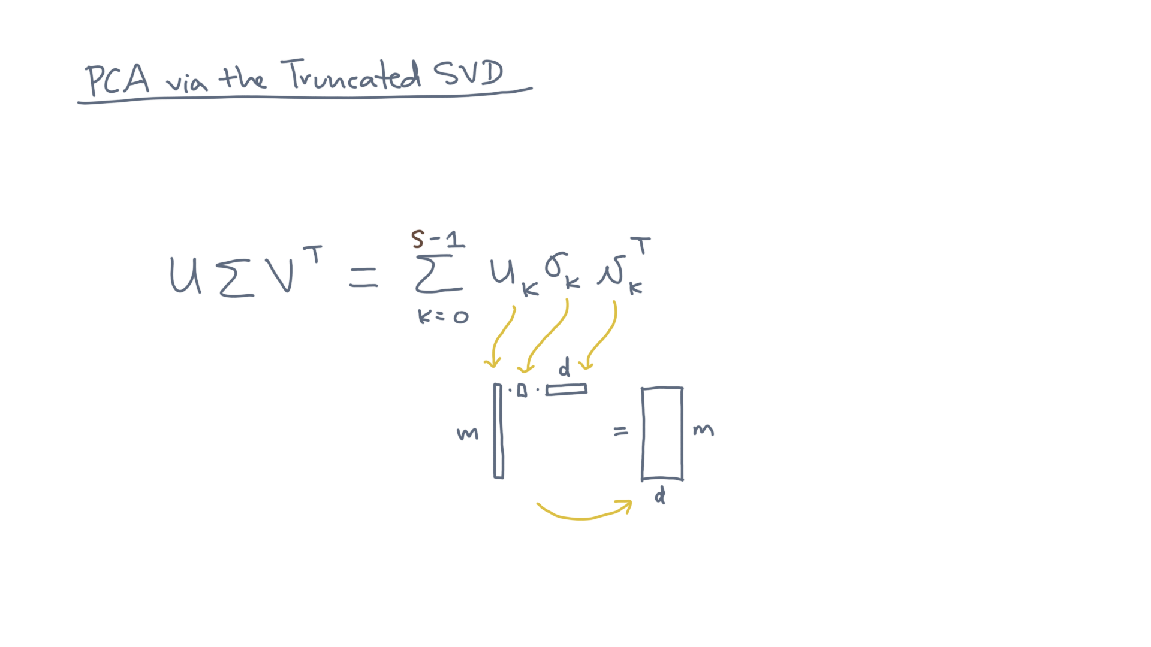
Notes:
It updates this running sum by what is referred to as a rank-one update.

Slide 39
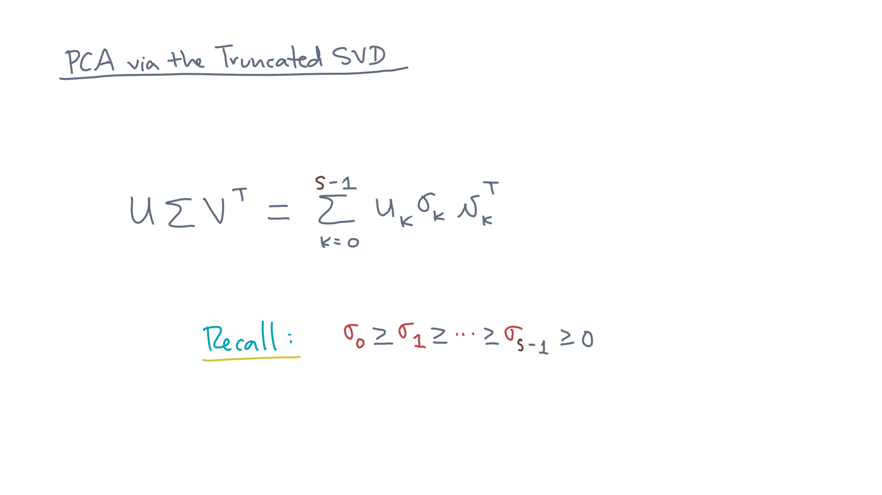
Notes:
Now, recall the convention about singular values.
They occur in descending order.

Slide 40
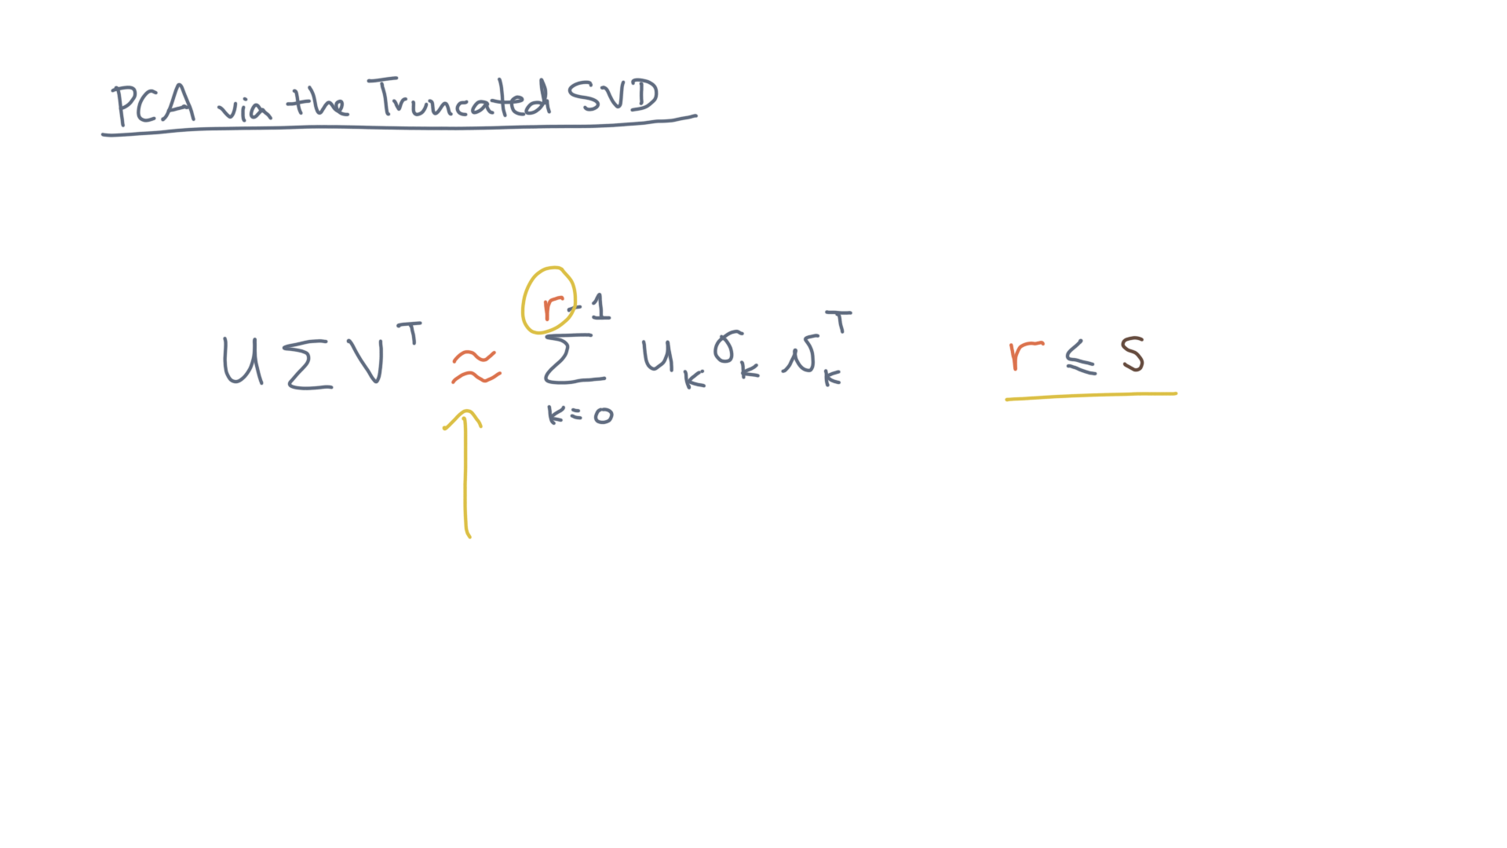
Notes:
So, let’s try to approximate the original SVD using just the first R terms.

Slide 41
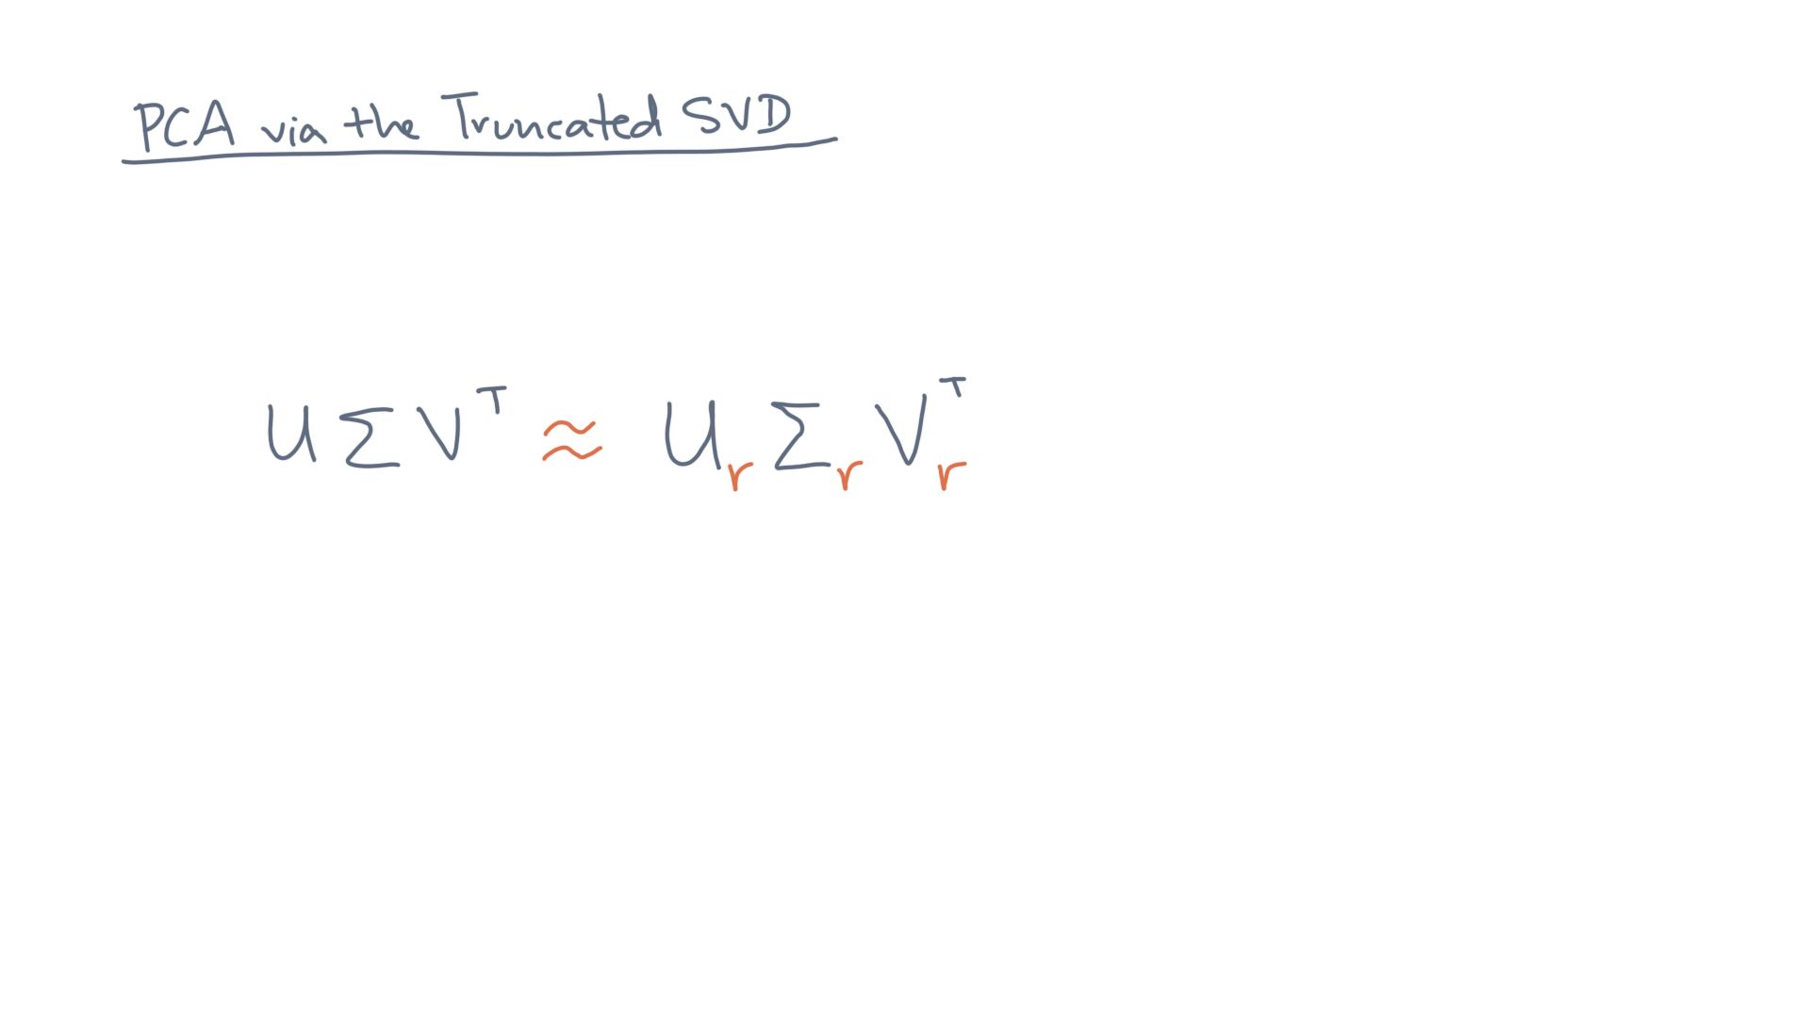
Notes:
Think of this truncation in matrix terms.

Slide 42
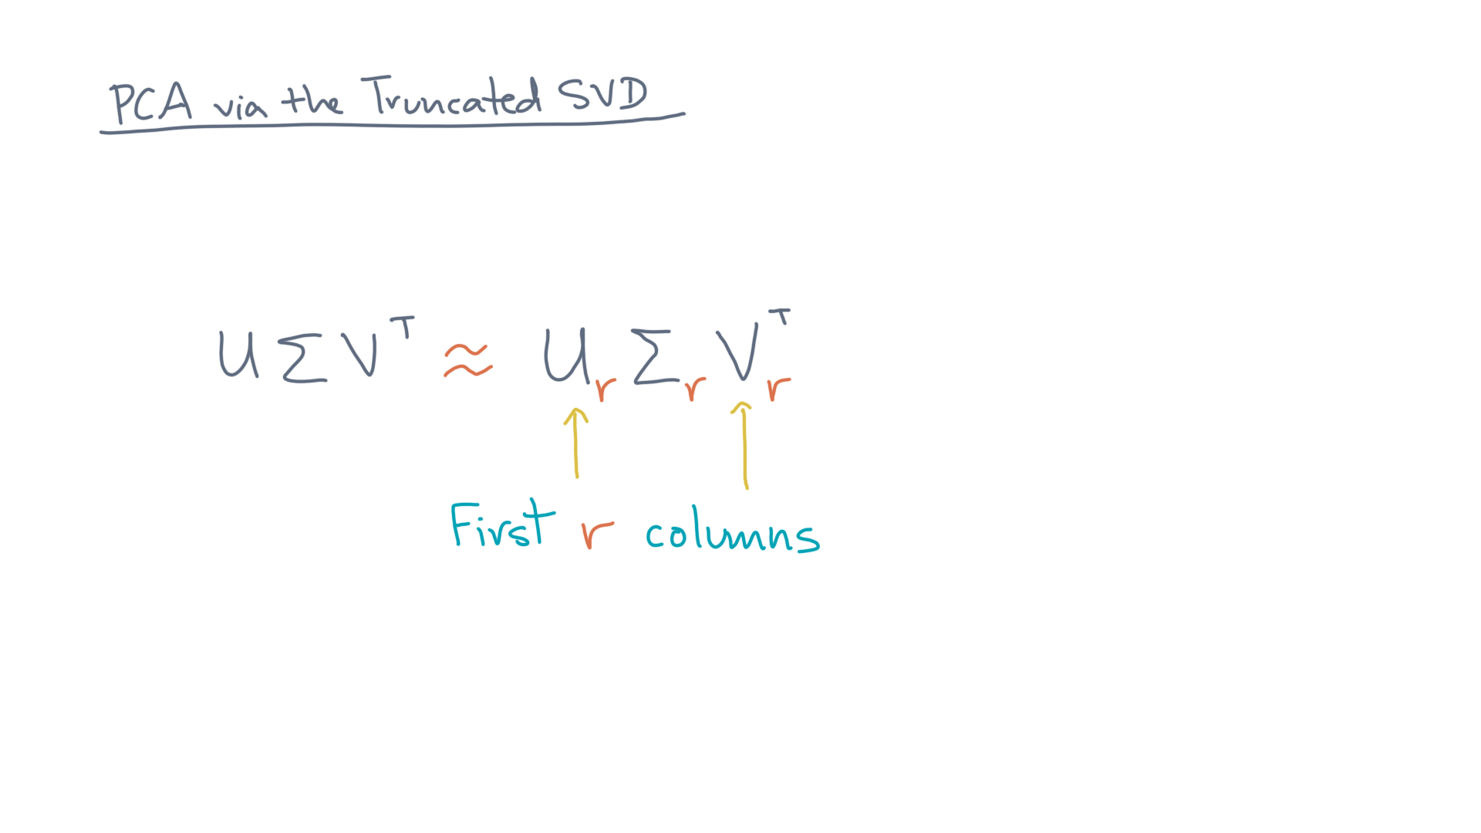
Notes:
U_R and V_R are the first R columns of U and V. @TODO: Show

Slide 43
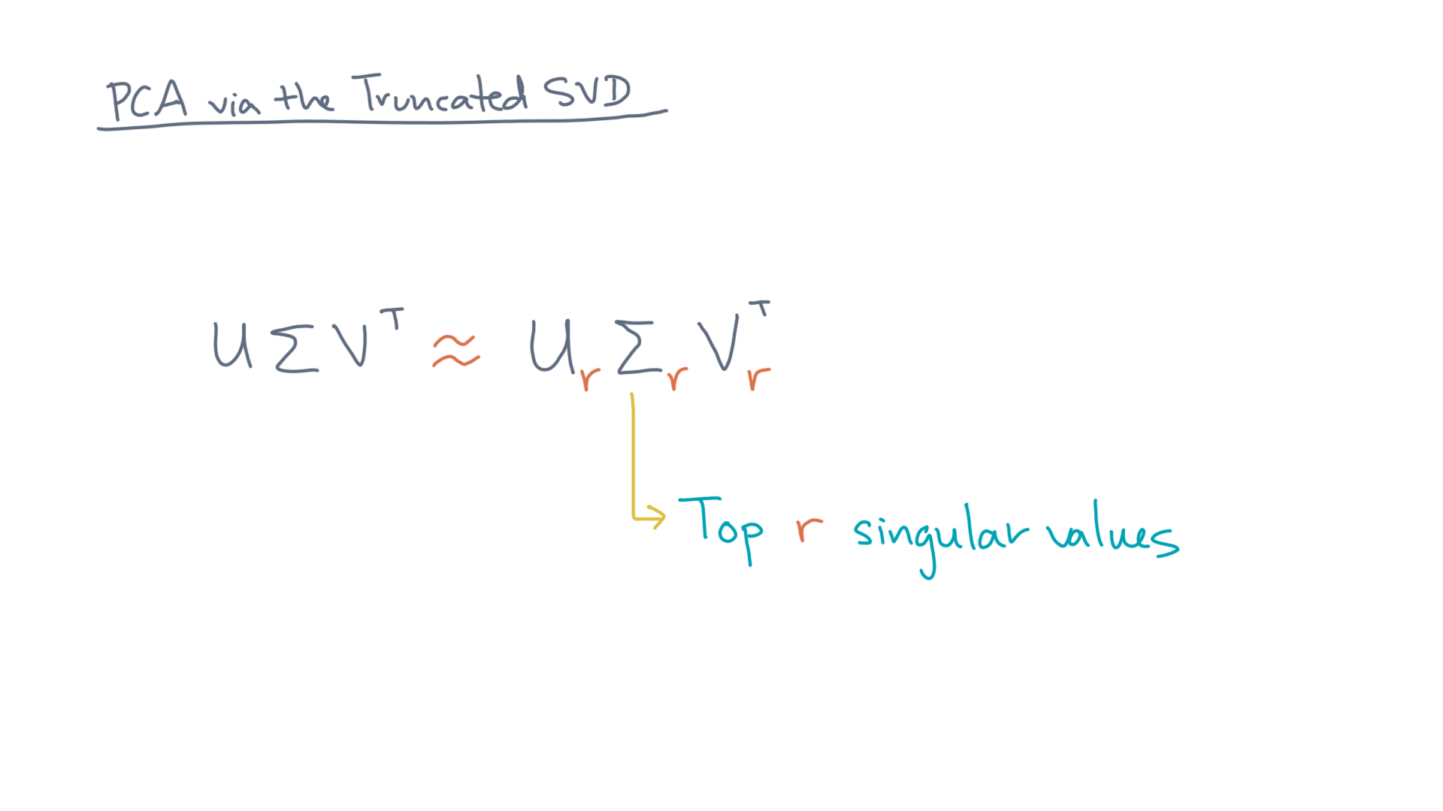
Notes:
Similarly, Sigma_R is the diagonal submatrix of the top R singular values. @TODO: Show

Slide 44
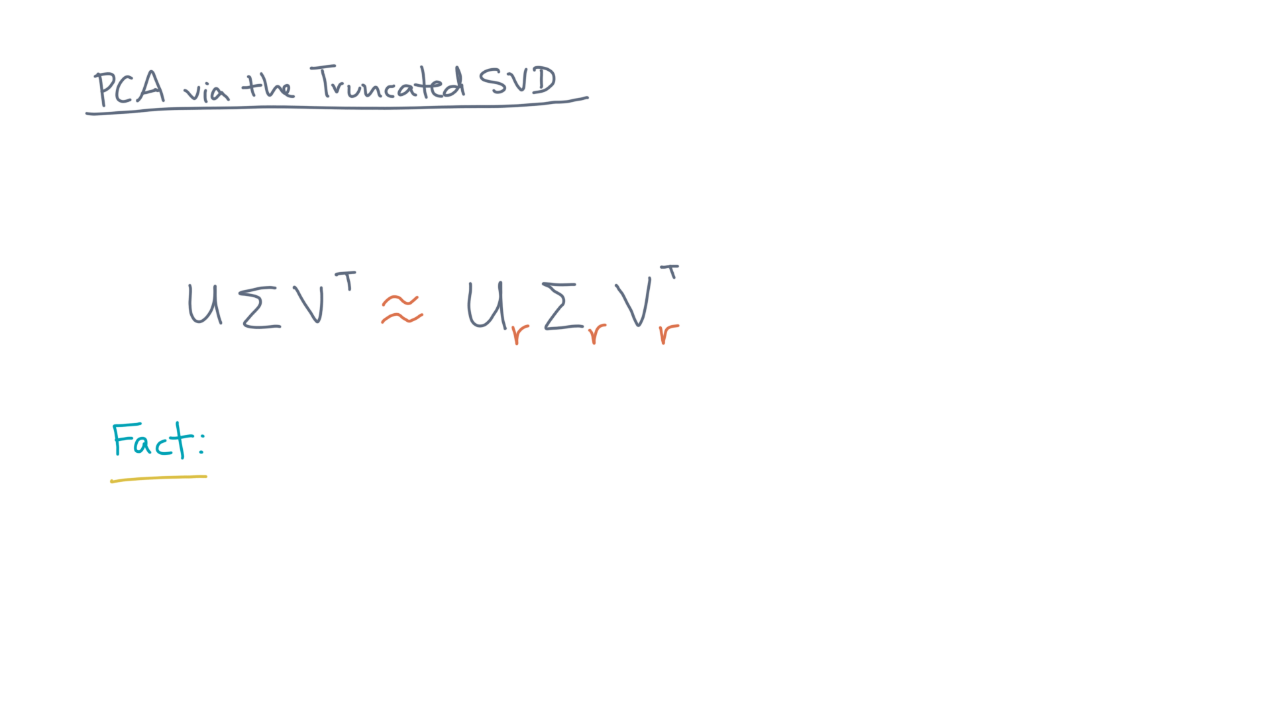
Notes:
Now here is a remarkable fact.

Slide 45
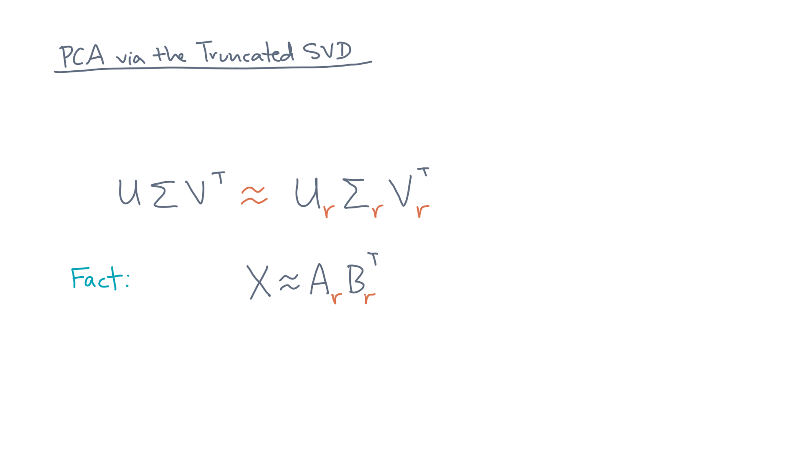
Notes:
Consider any other rank-R approximation of X, A_R times B_R transpose.

Slide 46
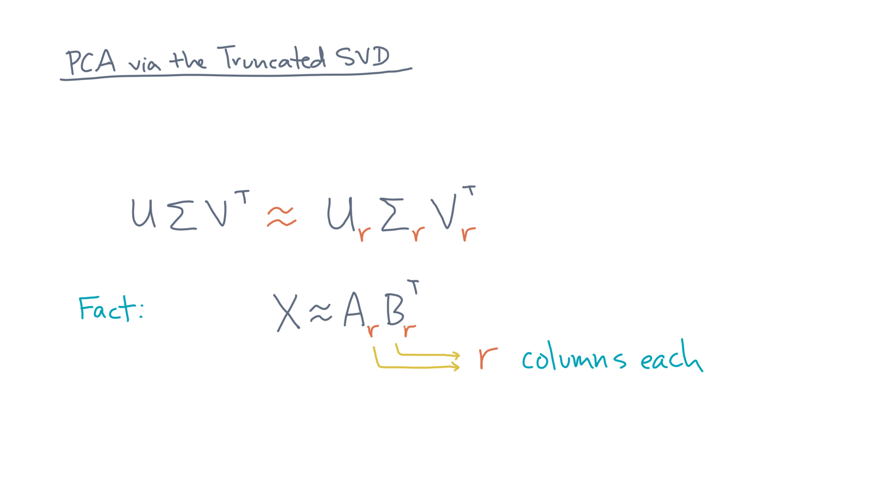
Notes:
A_R and B_R are matrices with R columns.

Slide 47
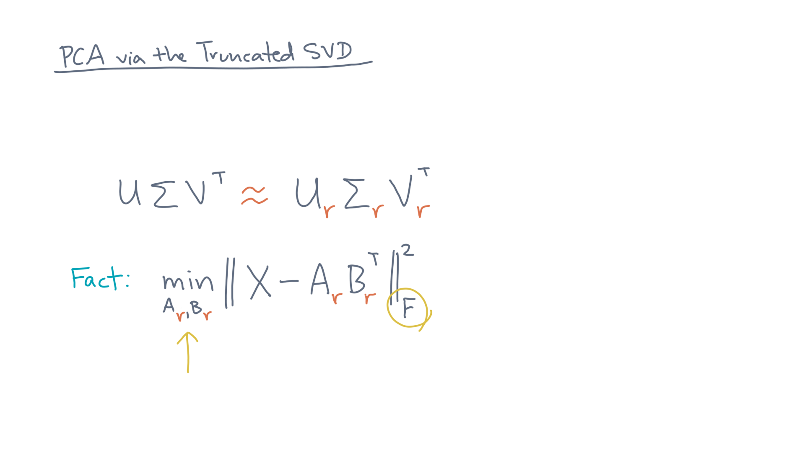
Notes:
What is the minimum possible error, measured in the Frobenius norm?

Slide 48
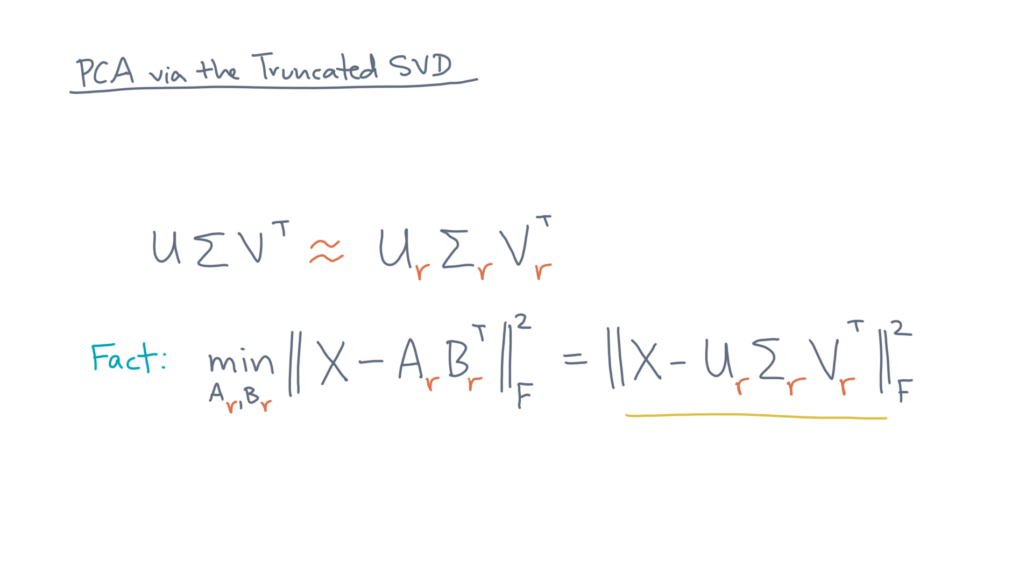
Notes:
It’s exactly the R-truncated SVD! @TODO: Write
Whoa, that’s neat.
And this minimum value can even be calculated explicitly.

Slide 49
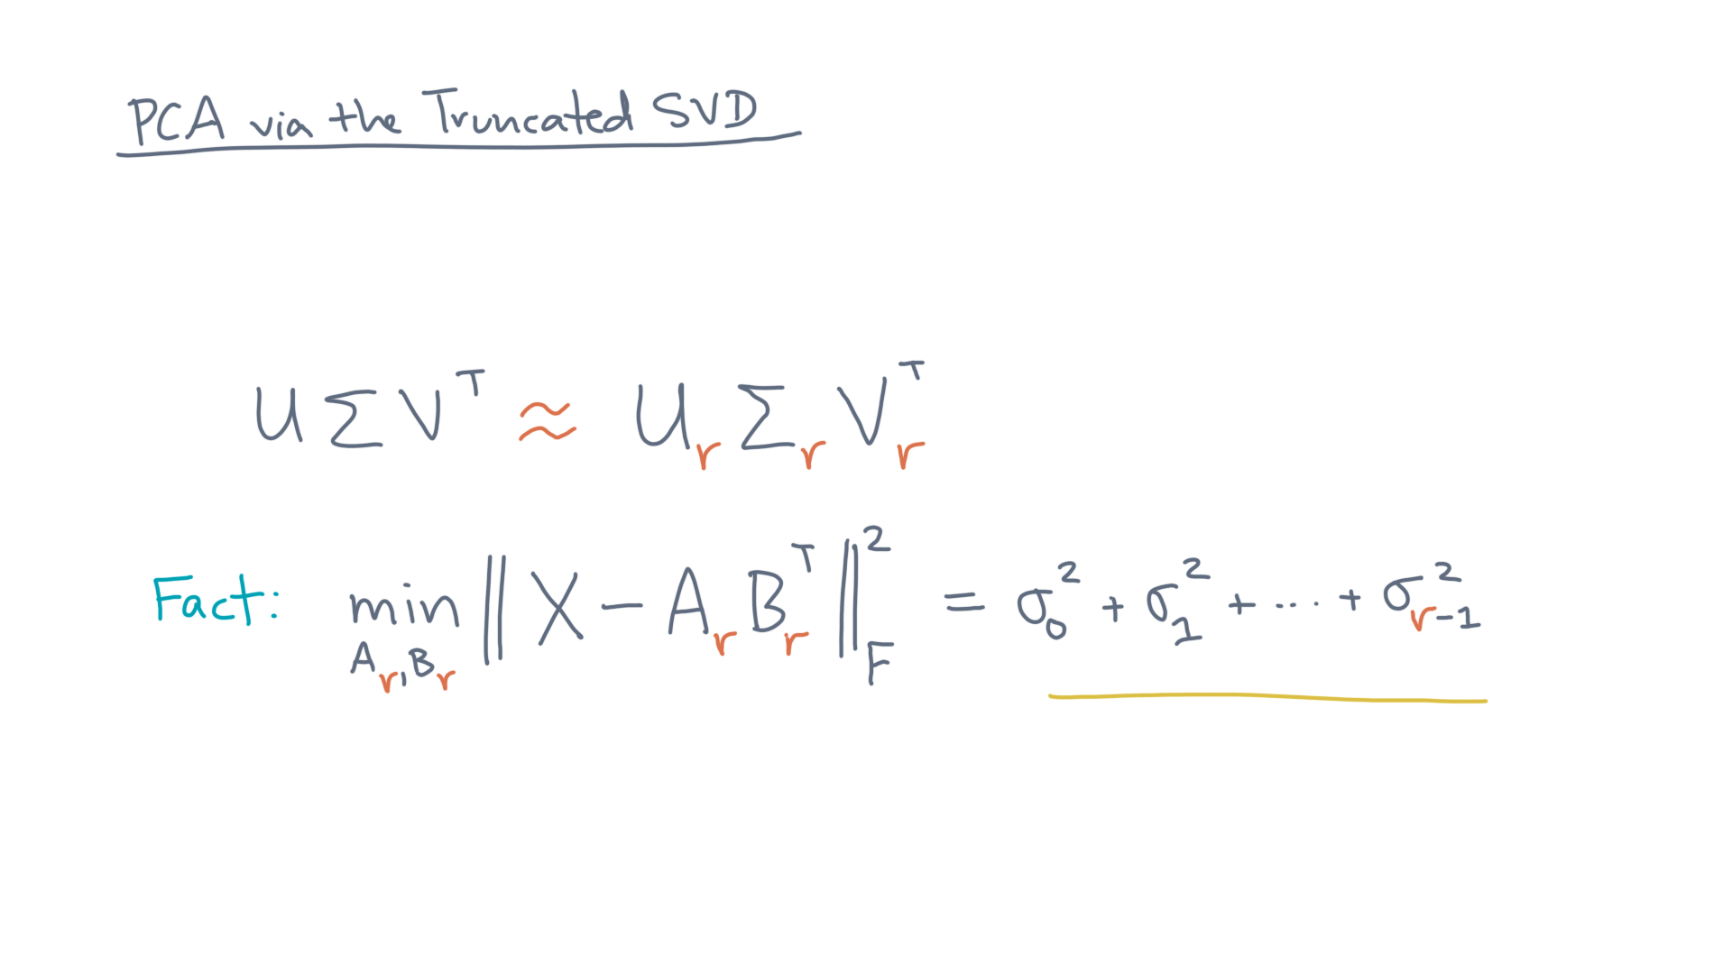
Notes:
It’s the sum of the top-R squared singular values.

Slide 50
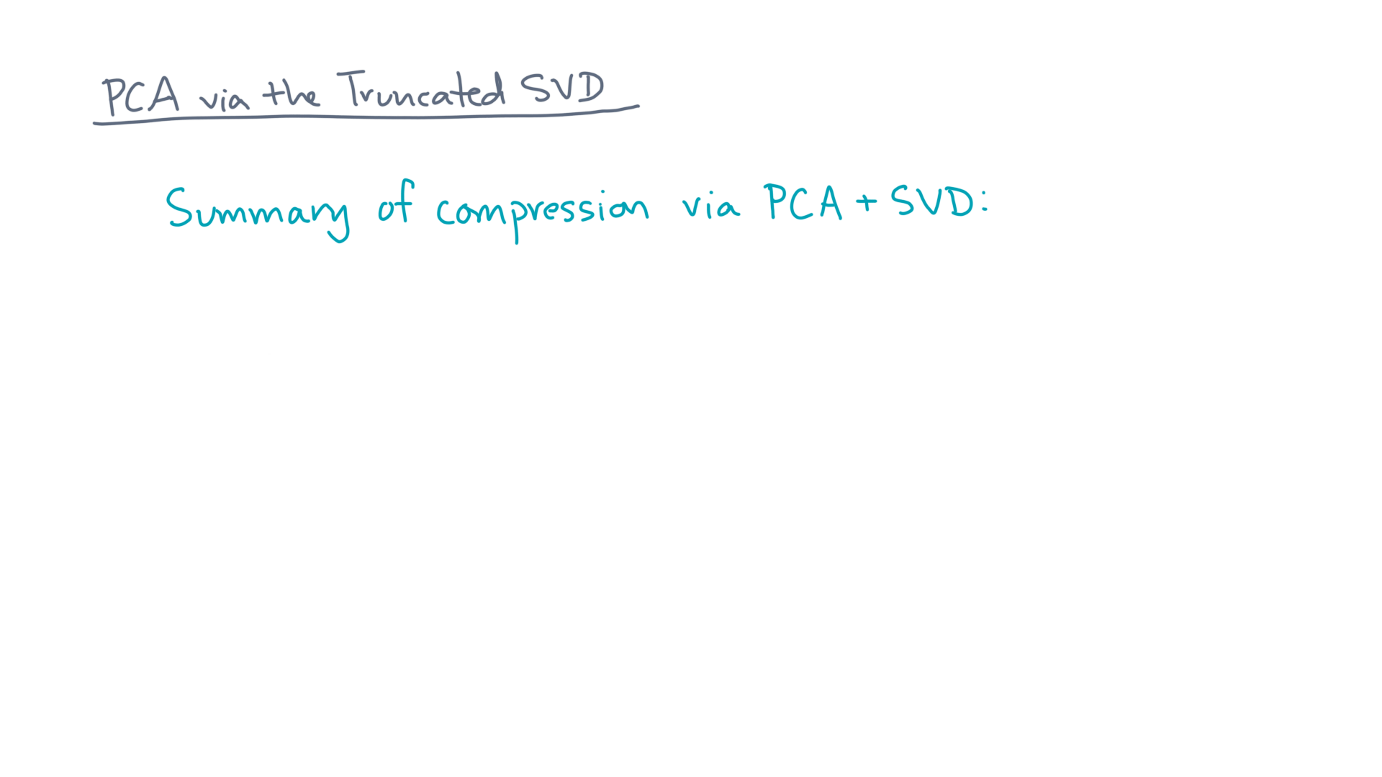
Notes:
So let’s summarize the compression process.

Slide 51
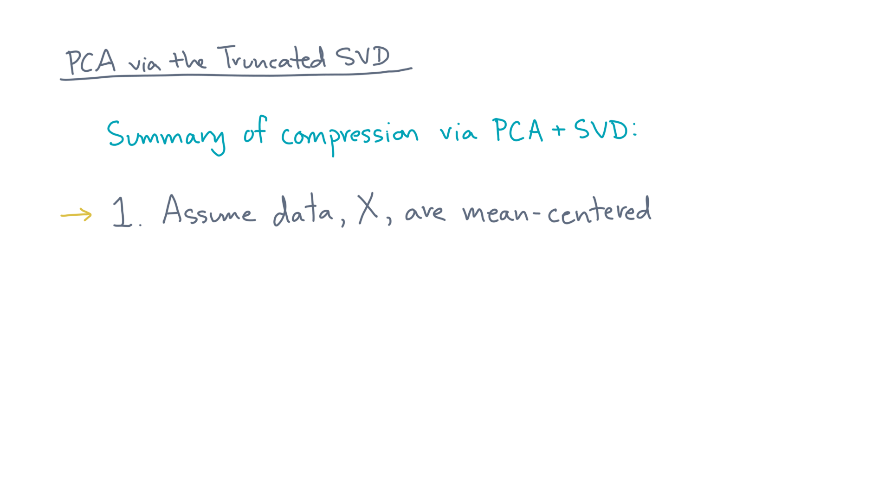
Notes:
First, assume X is centered. @TODO: Write
If it isn’t, make it so.

Slide 52
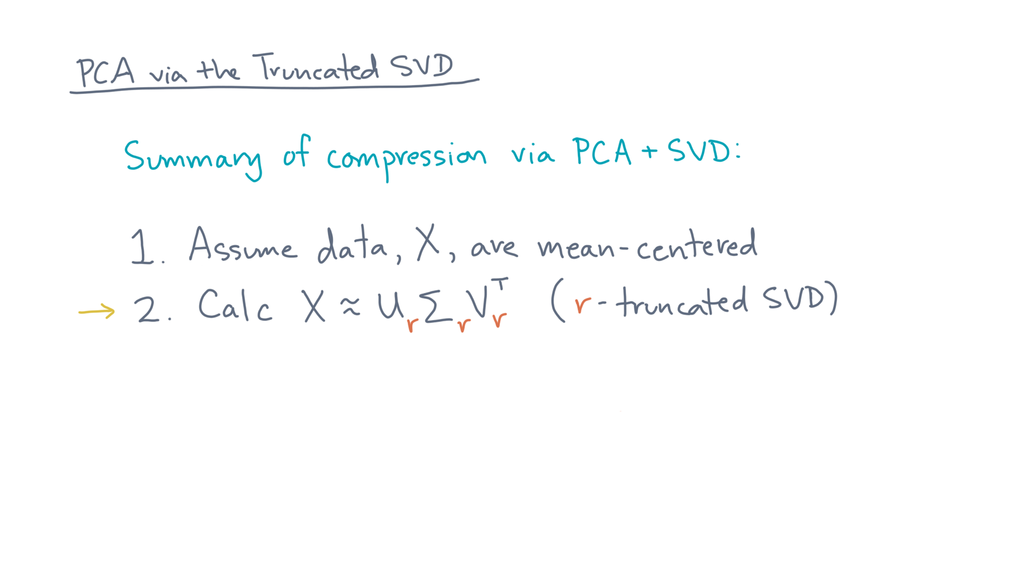
Notes:
Next, compute the R-truncated SVD.

Slide 53
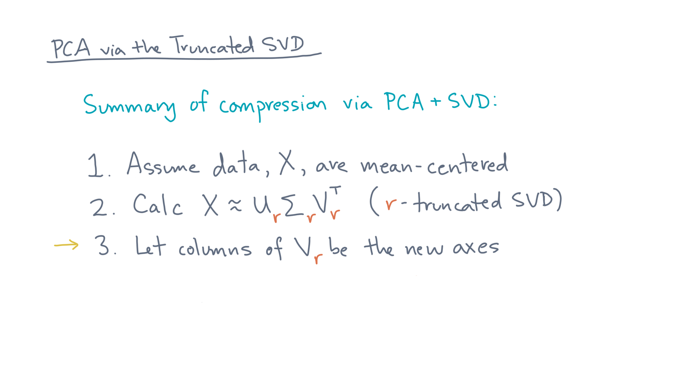
Notes:
Lastly, choose these right singular vectors to be the principal axes.

Slide 54

Notes:
That means you can compress X by projecting it onto V_R.

Slide 55
Notes:
So to sum up, you’ve just derived an algorithm for compressing a dataset!
You can use it to make an approximate, but smaller, version of the dataset.
Or, you can use it for dimensionality reduction.

Slide 56
Notes:
The key ideas are first, formulating the problem as one of computing a set of principal axes for the data.
Then, you can select a smaller number of axes using the truncated SVD.
In the notebook we made to go along with this lesson, you’ll implement this method and do some experiments, again, to give you a feel for how all this works in practice.

Slide 57
Notes:
Now, as a final step, there is one last notebook, which is a kind of mini-project.
It asks you to combine many of the ideas of the course, including more than one of the analysis techniques we’ve described.
I hope you’ll find it amusing, in addition to being a learning experience. So, have fun with it and see you again soon!

